Slide 1

June Learning Forum

Slide 2

Join us July 29 and 30 at Sporting Park in Kansas City, KS as we explore key drivers of maternal mortality in Kansas, including physical and mental health, substance use and intimate partner violence. Tailored for physicians, clinicians and perinatal professionals, the conference is zero cost to attend and will offer continuing education credits. Visit the registration page to sign up and get information on exhibiting opportunities.

Slide 3
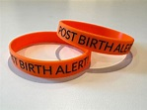
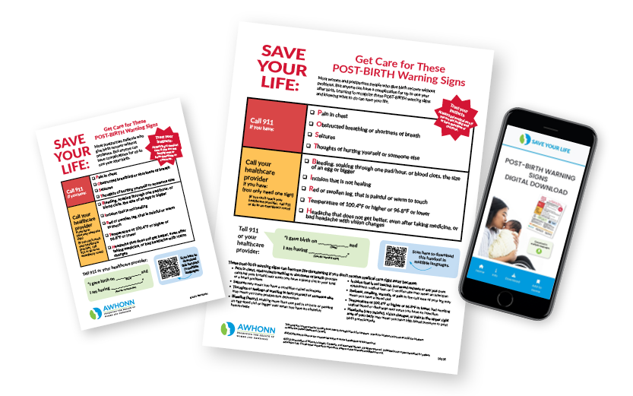
KPQC is proud to provide you with AWHONN Post-Birth Warning Signs bracelets as an additional tool to reinforce patient education, promote early recognition of maternal warning signs and support timely escalation of care after delivery. Incorporating the bracelets into bedside discharge teaching and daily patient interactions helps ensure families understand when to seek urgent medical attention and empowers them to speak up if symptoms arise. When used consistently alongside clinical assessment and standardized postpartum education, the bracelets can strengthen communication, improve patient engagement and enhance maternal safety across the continuum of care. Please use the following link to access the Implementation Toolkit - https://pbws.s3.us-east-1.amazonaws.com/PBWS+Alert+Bracelet+Toolkit.zip

Slide 4

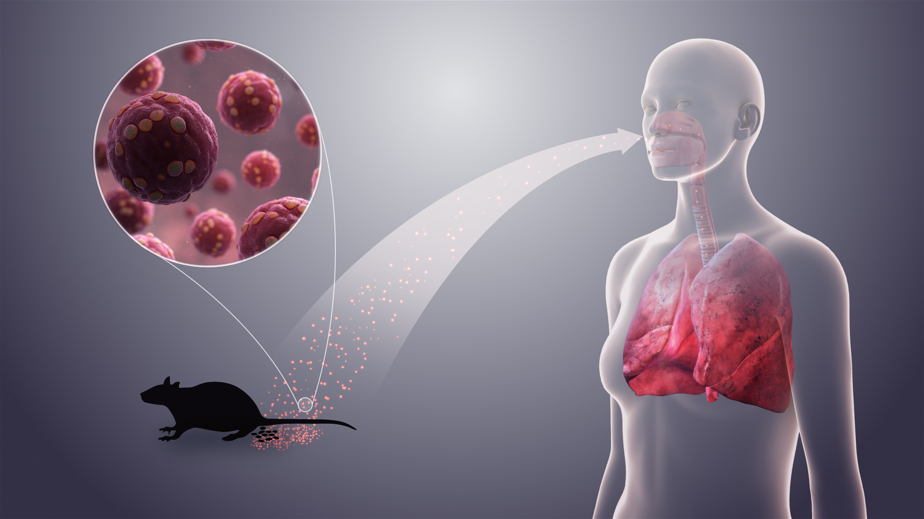
Hantavirus Key Points:
CDC is responding to a deadly outbreak of Andes virus, a type of hantavirus, among passengers and crew of a cruise ship in the Atlantic Ocean.
To date (June 21, 2026) , no cases of Andes virus have been confirmed in the United States as a result of this outbreak.
The risk of a pandemic caused by this outbreak and the overall risk to the American public and travelers is extremely low.

Slide 5
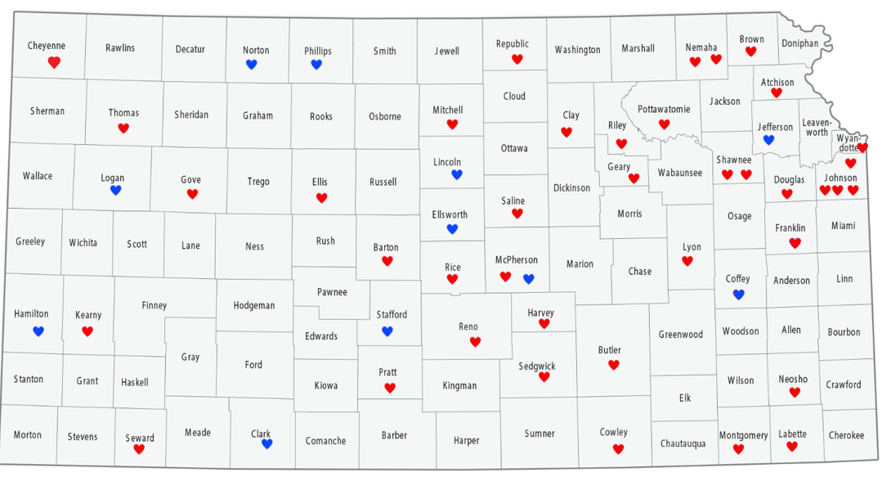

Impacting 83% of all births in KS
39 Birthing
Facilities
11 Non-birthing
Facilities
SHTN in Pregnancy Safety Bundle

Slide 6
Envisioned Referral Workflow
Inpatient Transfer
Transfer Protocol
Lactation Initiation
Specialty services
SSDOH needs
SHTN Model for Kansas
Primary OB/Medical Specialty Care
Breastfeeding Support
Recognize and
Respond
Identify Hypertension
SHTN Protocols
Screening for:
Medical conditions
Mental health
Substance use
Breastfeeding
Family planning
Structural and social drivers of health
Make AP/PP appointments
Cuff Project
Patient Debrief
Elevated Care Needed
WIC
Discharge
Home
Visiting
Outpatient Care
Appt with Primary OB 72 hours, 2-3 weeks
Refer to Navigator* and/or directly to needed services
Cuff Project
Patient Support Network
Comprehensive
PP Visit at 6-12 weeks PP
Discharge
Loop Closure
Behavioral Health
Housing, Transportation, Insurance, etc.
Other
Perinatal Care Team
* This may be a Home Visitor, OB Navigator, Doula, CHW, Case Manager, Care Coordinator, etc.

Slide 7
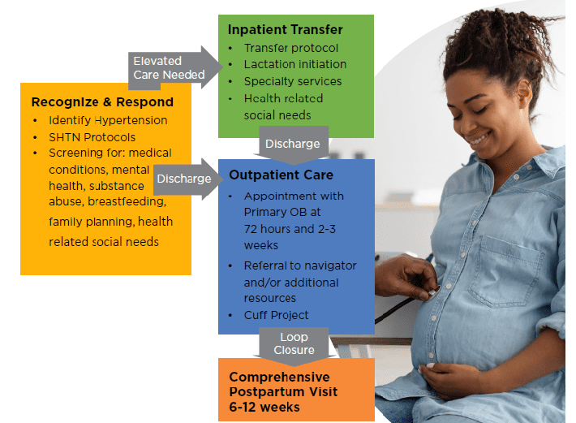
SHTN Model: Kansas!

Slide 8


SHTN Bundle Update
Severe HTN Bundle completion=
Dec. 2026

Slide 9

Next round of Data Collection: Coming July 1, due back to us Aug. 1!
This Photo by Unknown Author is licensed under CC BY-SA-NC

Slide 10

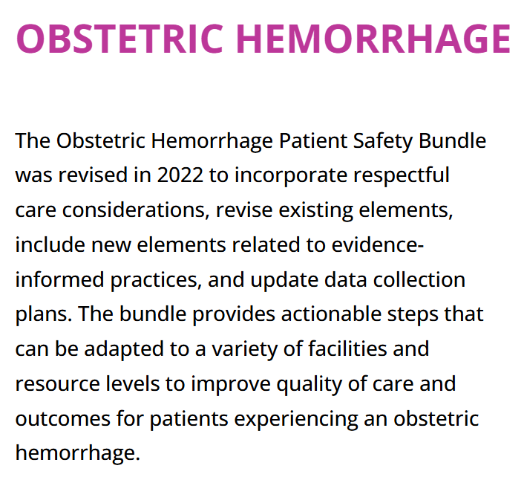
Next Bundle...
Jan. 2027

Slide 11
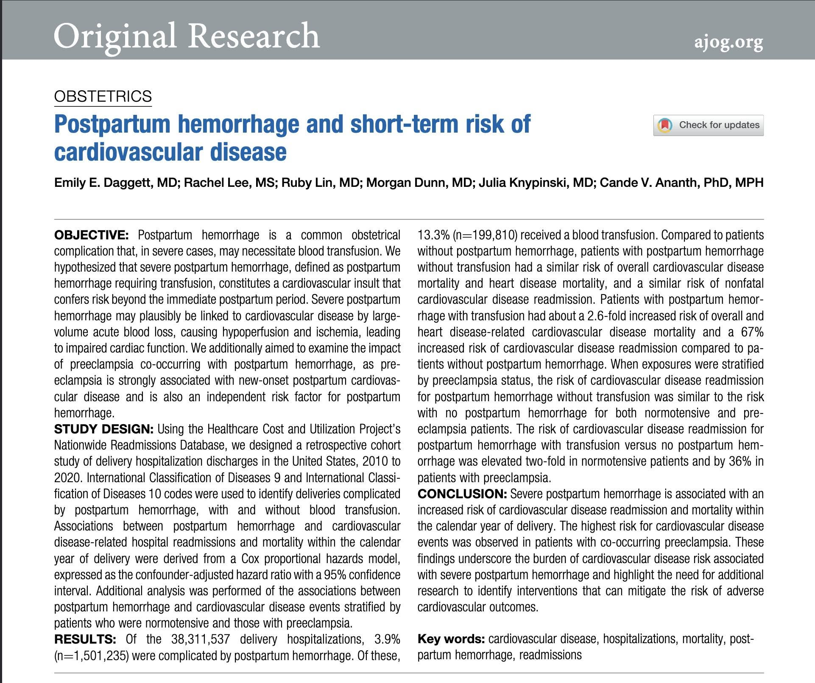
Rapid Response
Tying the
two bundles together.
PPH and Short Term Risk of Cardiovascular Disease Article

Slide 12
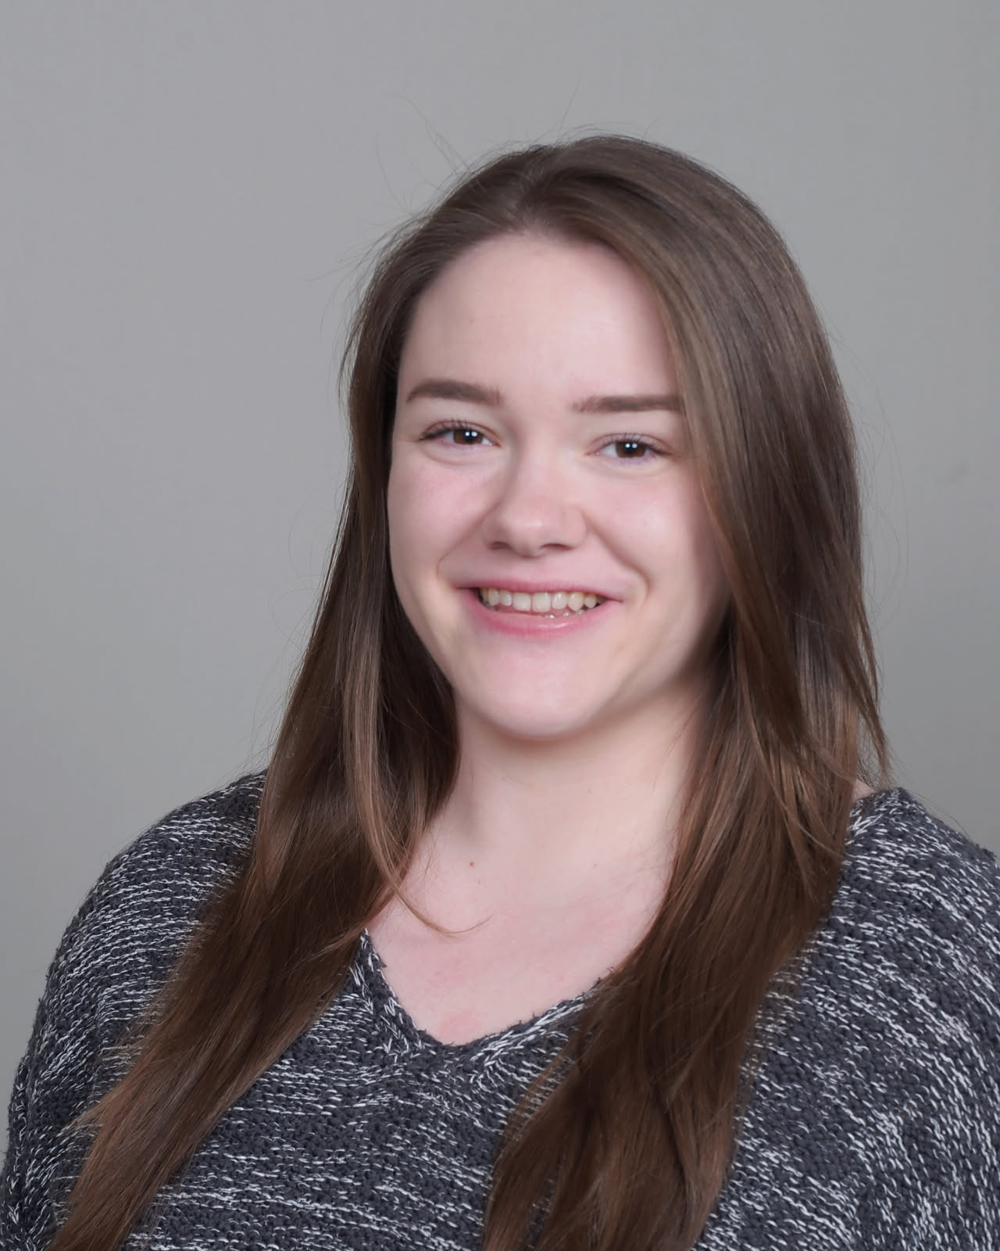

Rachele Wray
Rachele Wray is a program manager for the Kansas Department of Health and Environment - Division of Healthcare Finance's CMS funded Transforming Maternal Health cooperative grant. She has over seven years of experience leading and supporting initiatives and technical assistance centers focused on maternal health, behavioral health, and suicide prevention education.
Rachele’s work focuses on addressing behavioral health needs and the social and environmental factors that influence maternal health and well-being. She holds graduate degrees in Public Health and Public Affairs from the University of Missouri and is a Certified Health Education Specialist (CHES). She is passionate about advancing collaborative, community-centered approaches that support women, children and families.
Rachele Wray, MPH, MPA, CHES
TMaH Program Manager
Kansas Department of Health & Environment
Division of Health Care Finance
Phone: (785) 631-0704
Email: Rachele.wray@ks.gov

Slide 13
Next Steps
Aug. 25 Learning Forum
Individual TA

