Slide 1

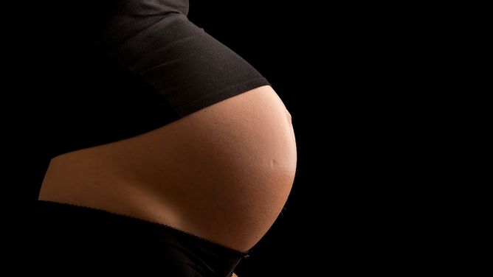

Kansas birth equity Training: education to create birth equity in Kansas
Sharla Smith, PhD. MPH
Associate Professor, Department of Population Health
Director of Birth Equity, Department of Obstetrics & Gynecology
Founder & Director, Kansas Birth Equity Network
University of Kansas Medical Center

Slide 2
Parent Experience
Daysha Lewis
  My postpartum experience and the experiences I see in the state of Kansas
  The importance of doulas in Kansas for patients
  The importance of birth equity community conversations such as the KBEN Black Maternal Health week discussion to the Kansas community.

Slide 3
Mission and
Visions
Mission
To use a community centered approach to create solutions that improve Black maternal, paternal, and infant health in Kansas through training, research, healthcare, and advocacy
Vision
  KBEN Vision : Every Black mom, dad, and infant receive quality and intentional prenatal, neonatal, and postpartum care in the state of Kansas
  CD366 Vision: Every Black birthing person, dad, partner, and baby celebrates the baby’s first birthday

Slide 4
Significance: The story the data doesn’t tell
Chronic stress, particularly due to racial discrimination, presents numerous difficulties for Black women throughout the perinatal journey.
When patients are not heard, there is not only the possibility to experience adverse health outcomes, but it also directly highlights perinatal silencing of Black women.
Society, research, public health work in this area only think of Black communities in a deficient, marginalized, underrepresented, vulnerable, poor, and uneducated.

Slide 5
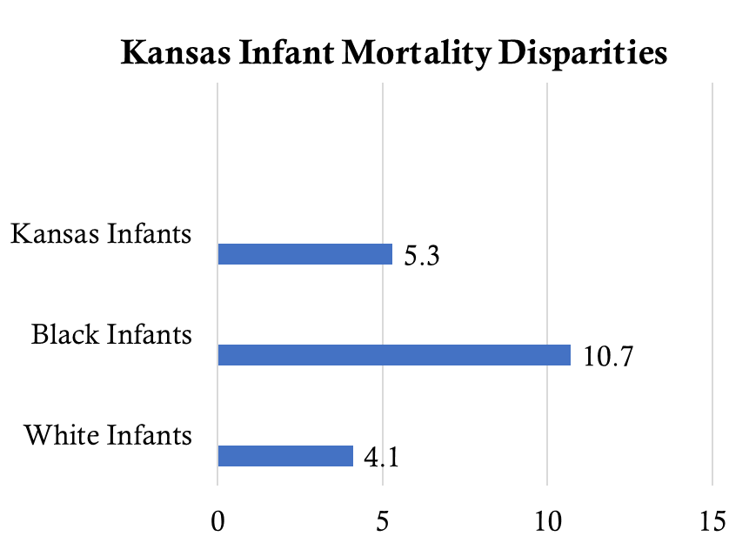
The Disparities in Kansas
AHR, 2019

Slide 6
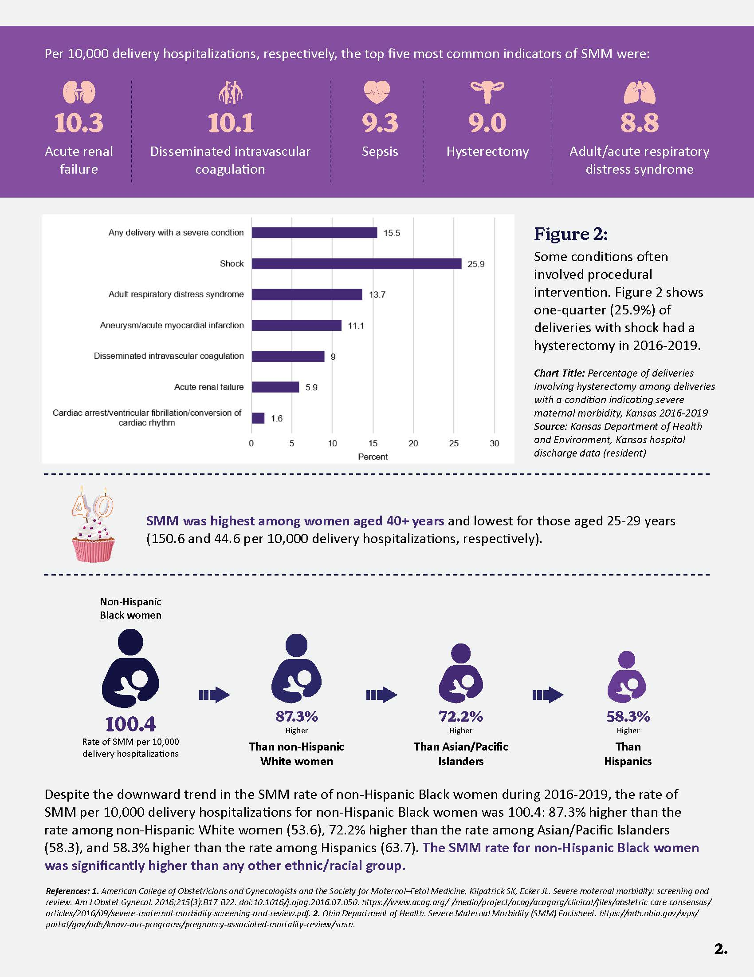
Severe Maternal Morbidity
Severe maternal morbidity (SMM) occurs nearly 100 times more frequently than maternal death.
SMM in Kansas KDHE, 2021

Slide 7
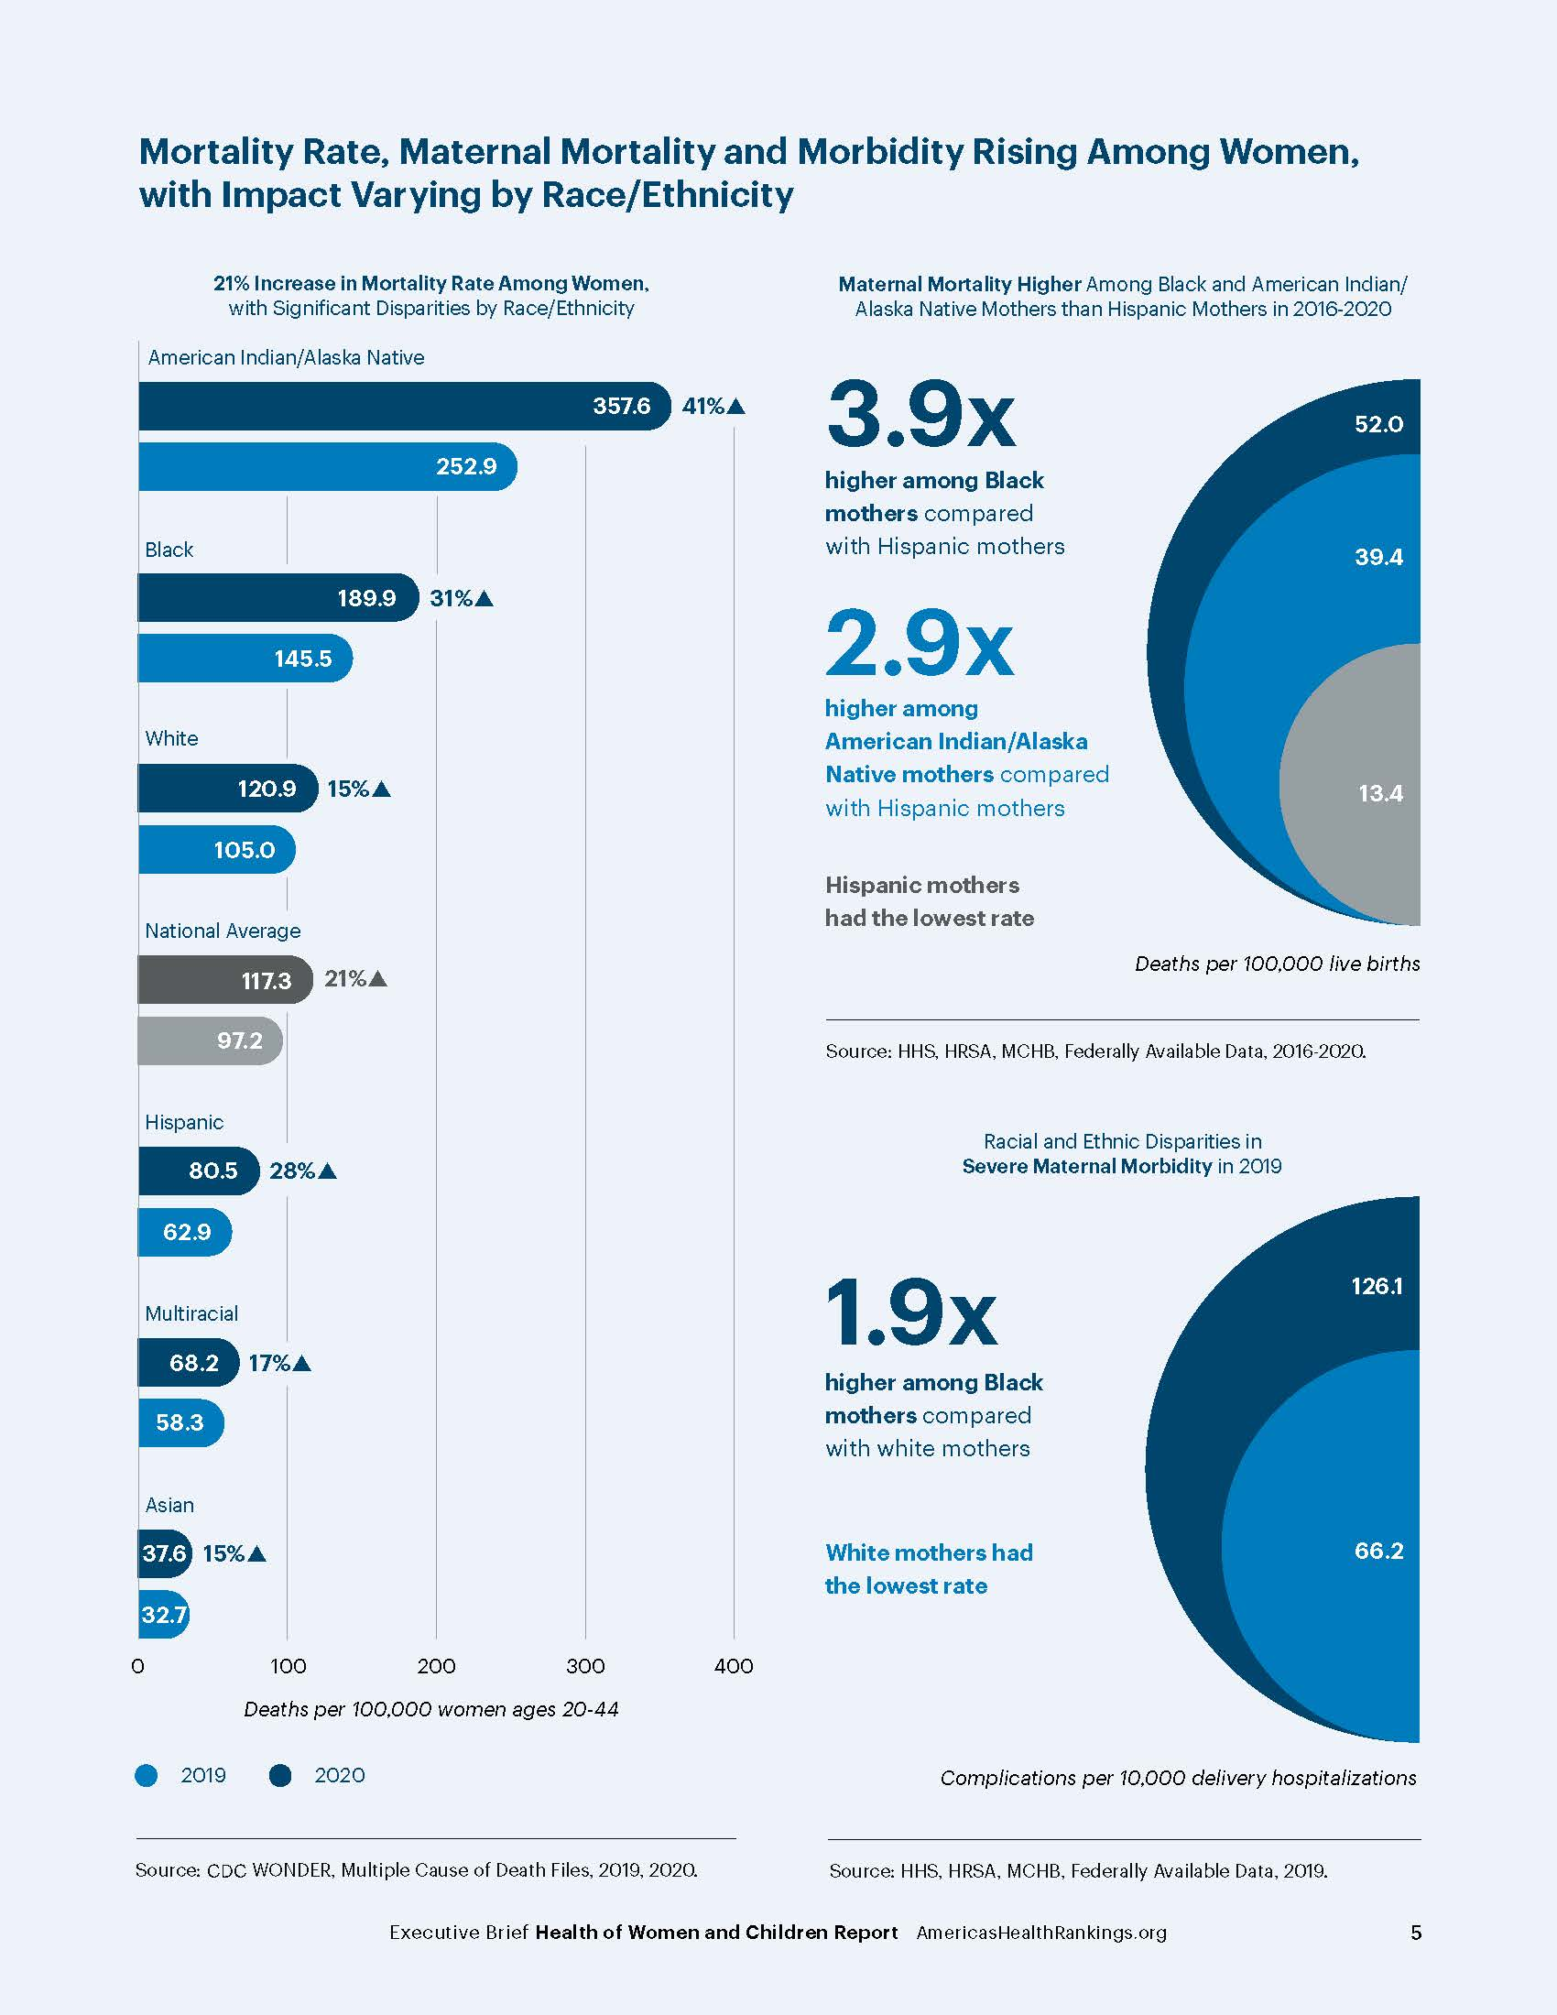
National Outlook
In 2016-2020, maternal mortality was 3.9 times higher among Black mothers compared with Hispanic mothers.

Slide 8
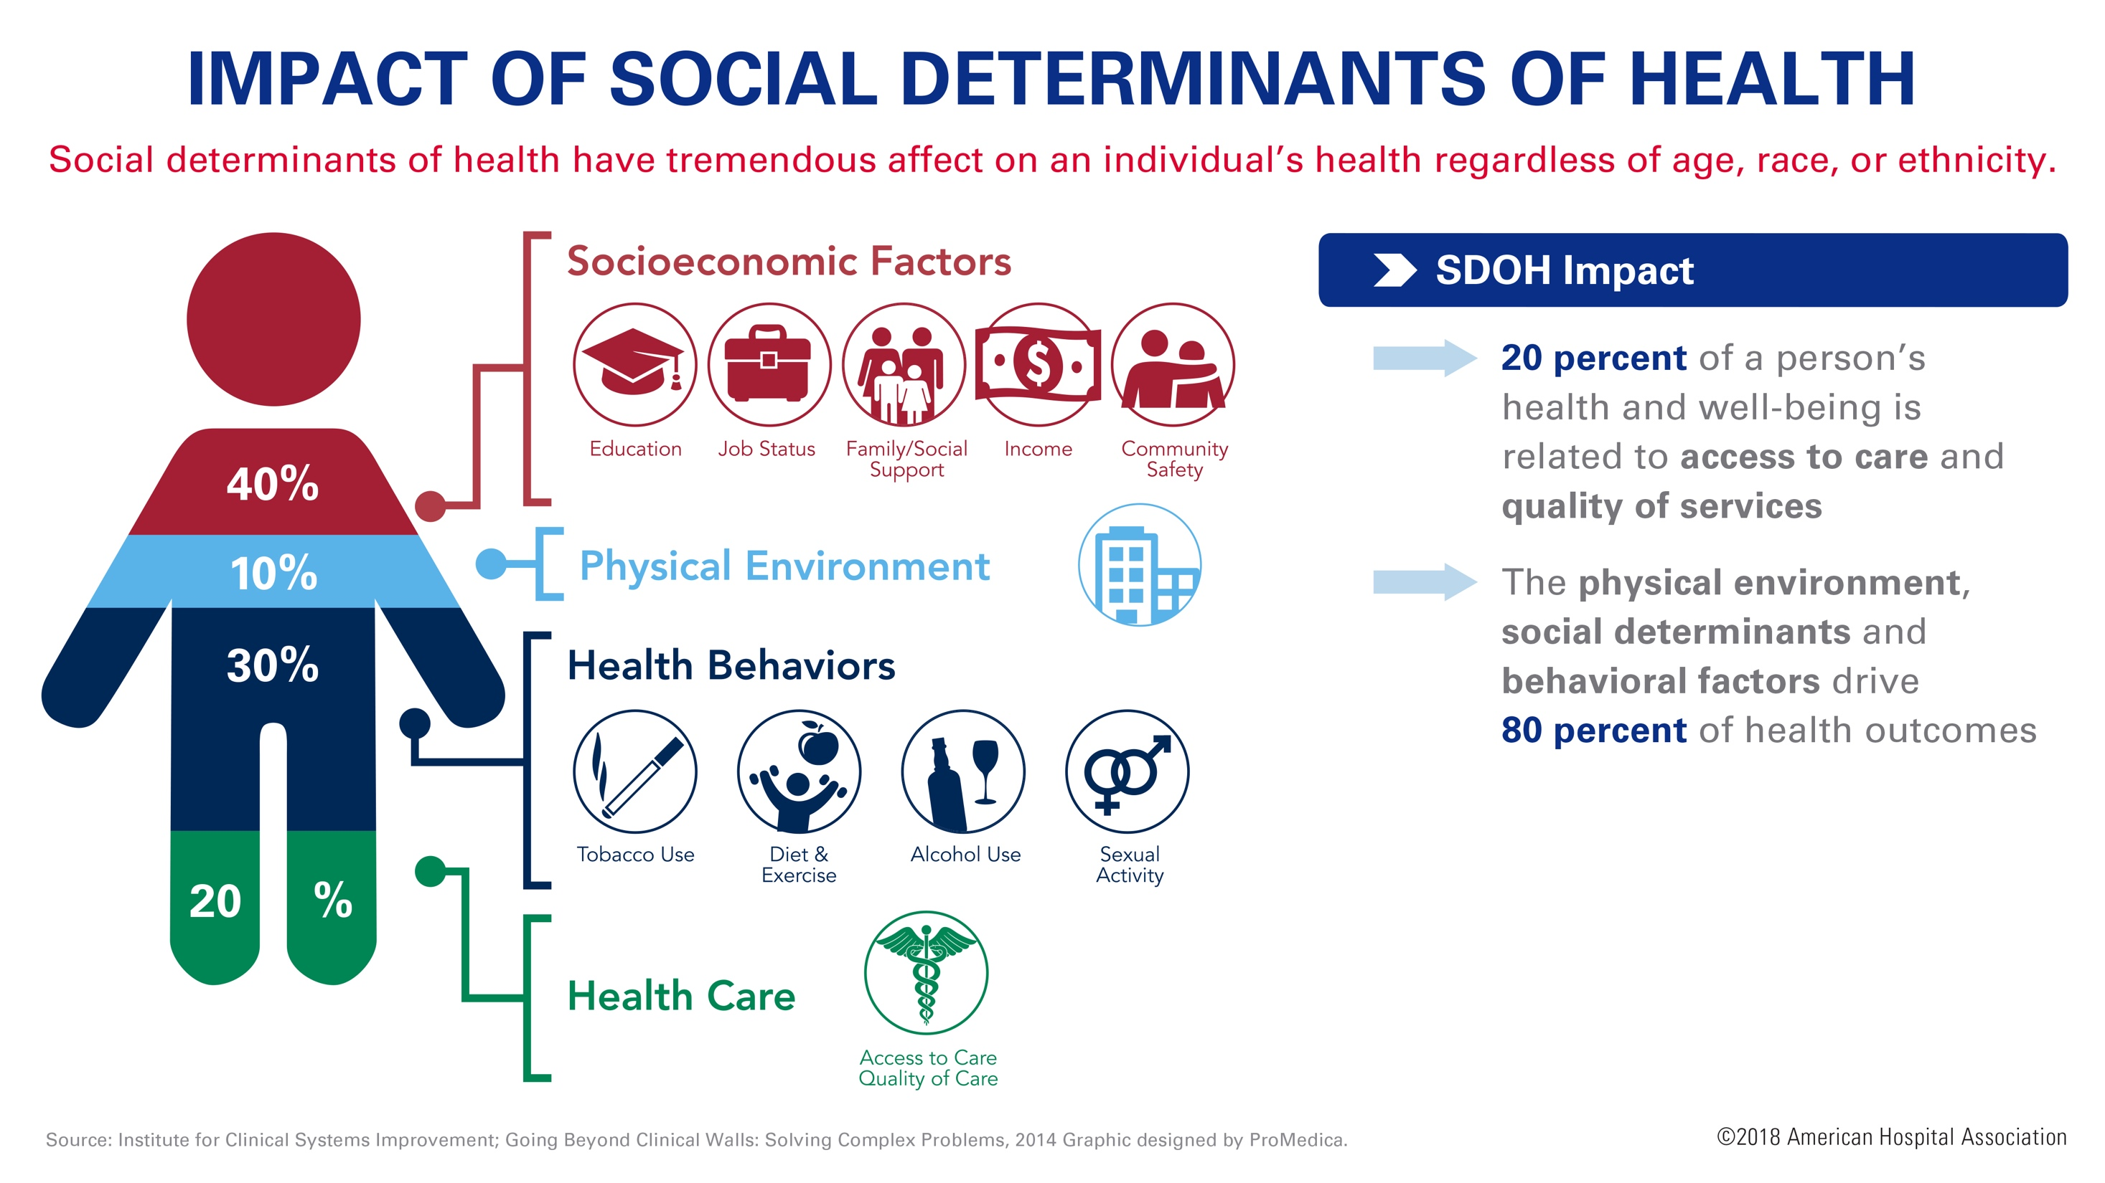
Infant Health
There were 189 infant deaths to Kansas residents in 2019
The infant mortality rate for Kansas residents in 2019 was 5.3 infant deaths per 1,000 live births
The rate for White non-Hispanic mothers in 2019 decreased 14.6% yet the Black non-Hispanic mothers increased 7.0% from the in 2018.
(per 1,000 births)
Maternal Health
Kansas maternal mortality rate of 14.8 (2014-2018) is 29.8% higher than the Healthy People 2020
The proportion of deaths that occurred among non-Hispanic Black women (23.1%), Hispanic women (23.1%), non-Hispanic women of other races (15.4%) far exceeded their representation among the population of women giving birth (7.1%, 16.2%, 6.8%, respectively) in Kansas
                Source: American Health Rankings, 2018 and KDHE, 2019
(per 100,000 births)
Notes:
17.7 currently a decrease
Kira’s story: https://youtu.be/MYHb6NoBWho
https://www.youtube.com/watch?v=AODAk-accVc
https://www.youtube.com/watch?v=qzuMxI3-km8
https://www.youtube.com/watch?v=ELET24AHn
Eg
https://www.youtube.com/watch?v=MYHb6NoBWho
Time 14:50
https://www.youtube.com/watch?v=AQVNN76hkR4

Slide 9
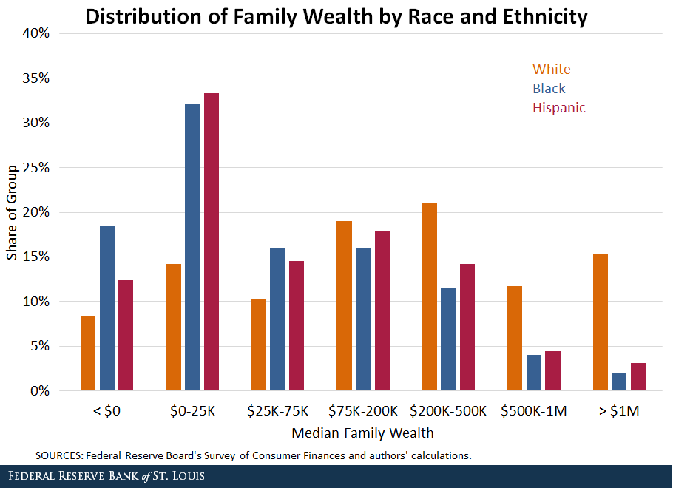
No progress has been made in reducing income and wealth inequalities between black and white households over the past 70 years,”
Notes:
The vast majority of Black (82%) and Hispanic (76%) families had less wealth than the typical white family at the median. In fact, the entire wealth distributions of Black and Hispanic families are shifted toward lower wealth, while the distribution of white families is more evenly dispersed, as seen in the figure below.

Slide 10
Finding the Root of Inequities
Black mothers who are college educated fare worse than women of all other races who never finished high school
Obese women of all races have better birth outcomes than black women who are of normal weight
Black women in the wealthiest neighborhoods do worse than White, Hispanic, and Asian mothers in the poorest ones
Black women who initiated prenatal care in the first trimester still have higher rates of infant mortality than non-Hispanic white women with late to no prenatal care.

Slide 11
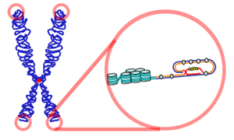

Racial Differences in Telomere Length
Telomeres are sequences of DNA at end of chromosome. Telomere length is viewed as an overall marker of biological aging
Study found that Black women had shorter telomeres than White women
At same chronological age, black women had accelerated biological aging of about 7.5 years
Geronimus et al., Human Nature, 2010
Notes:
The term “weathering” describes how the constant stress of racism may lead to premature biological aging and poor health outcomes for black people, like disproportionately high death rates from chronic conditions such as heart disease, stroke, diabetes, and most cancers.

Slide 12
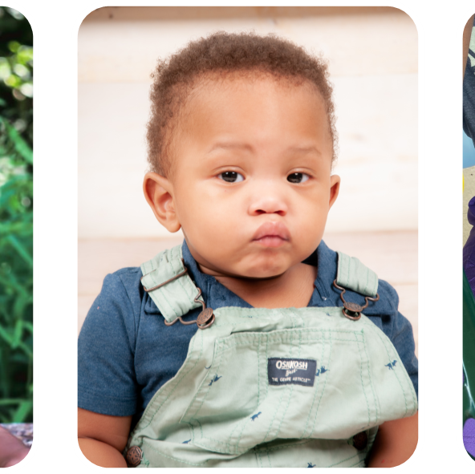
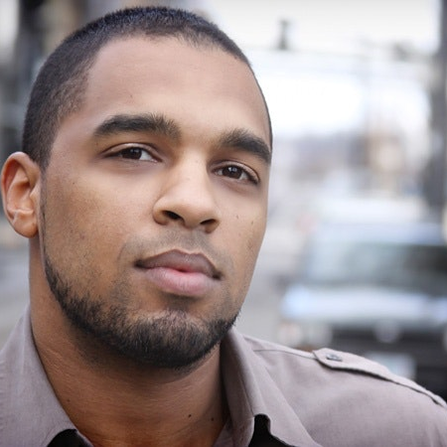
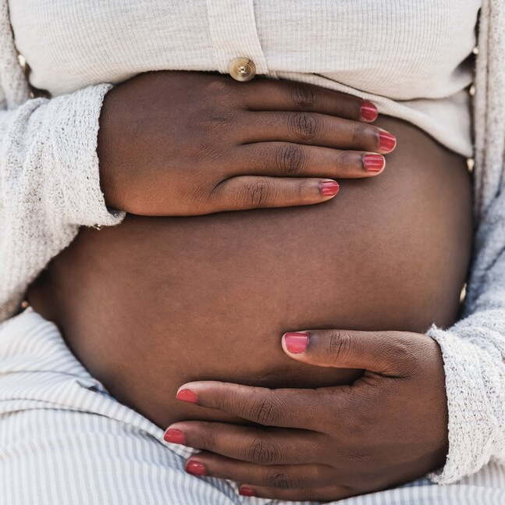
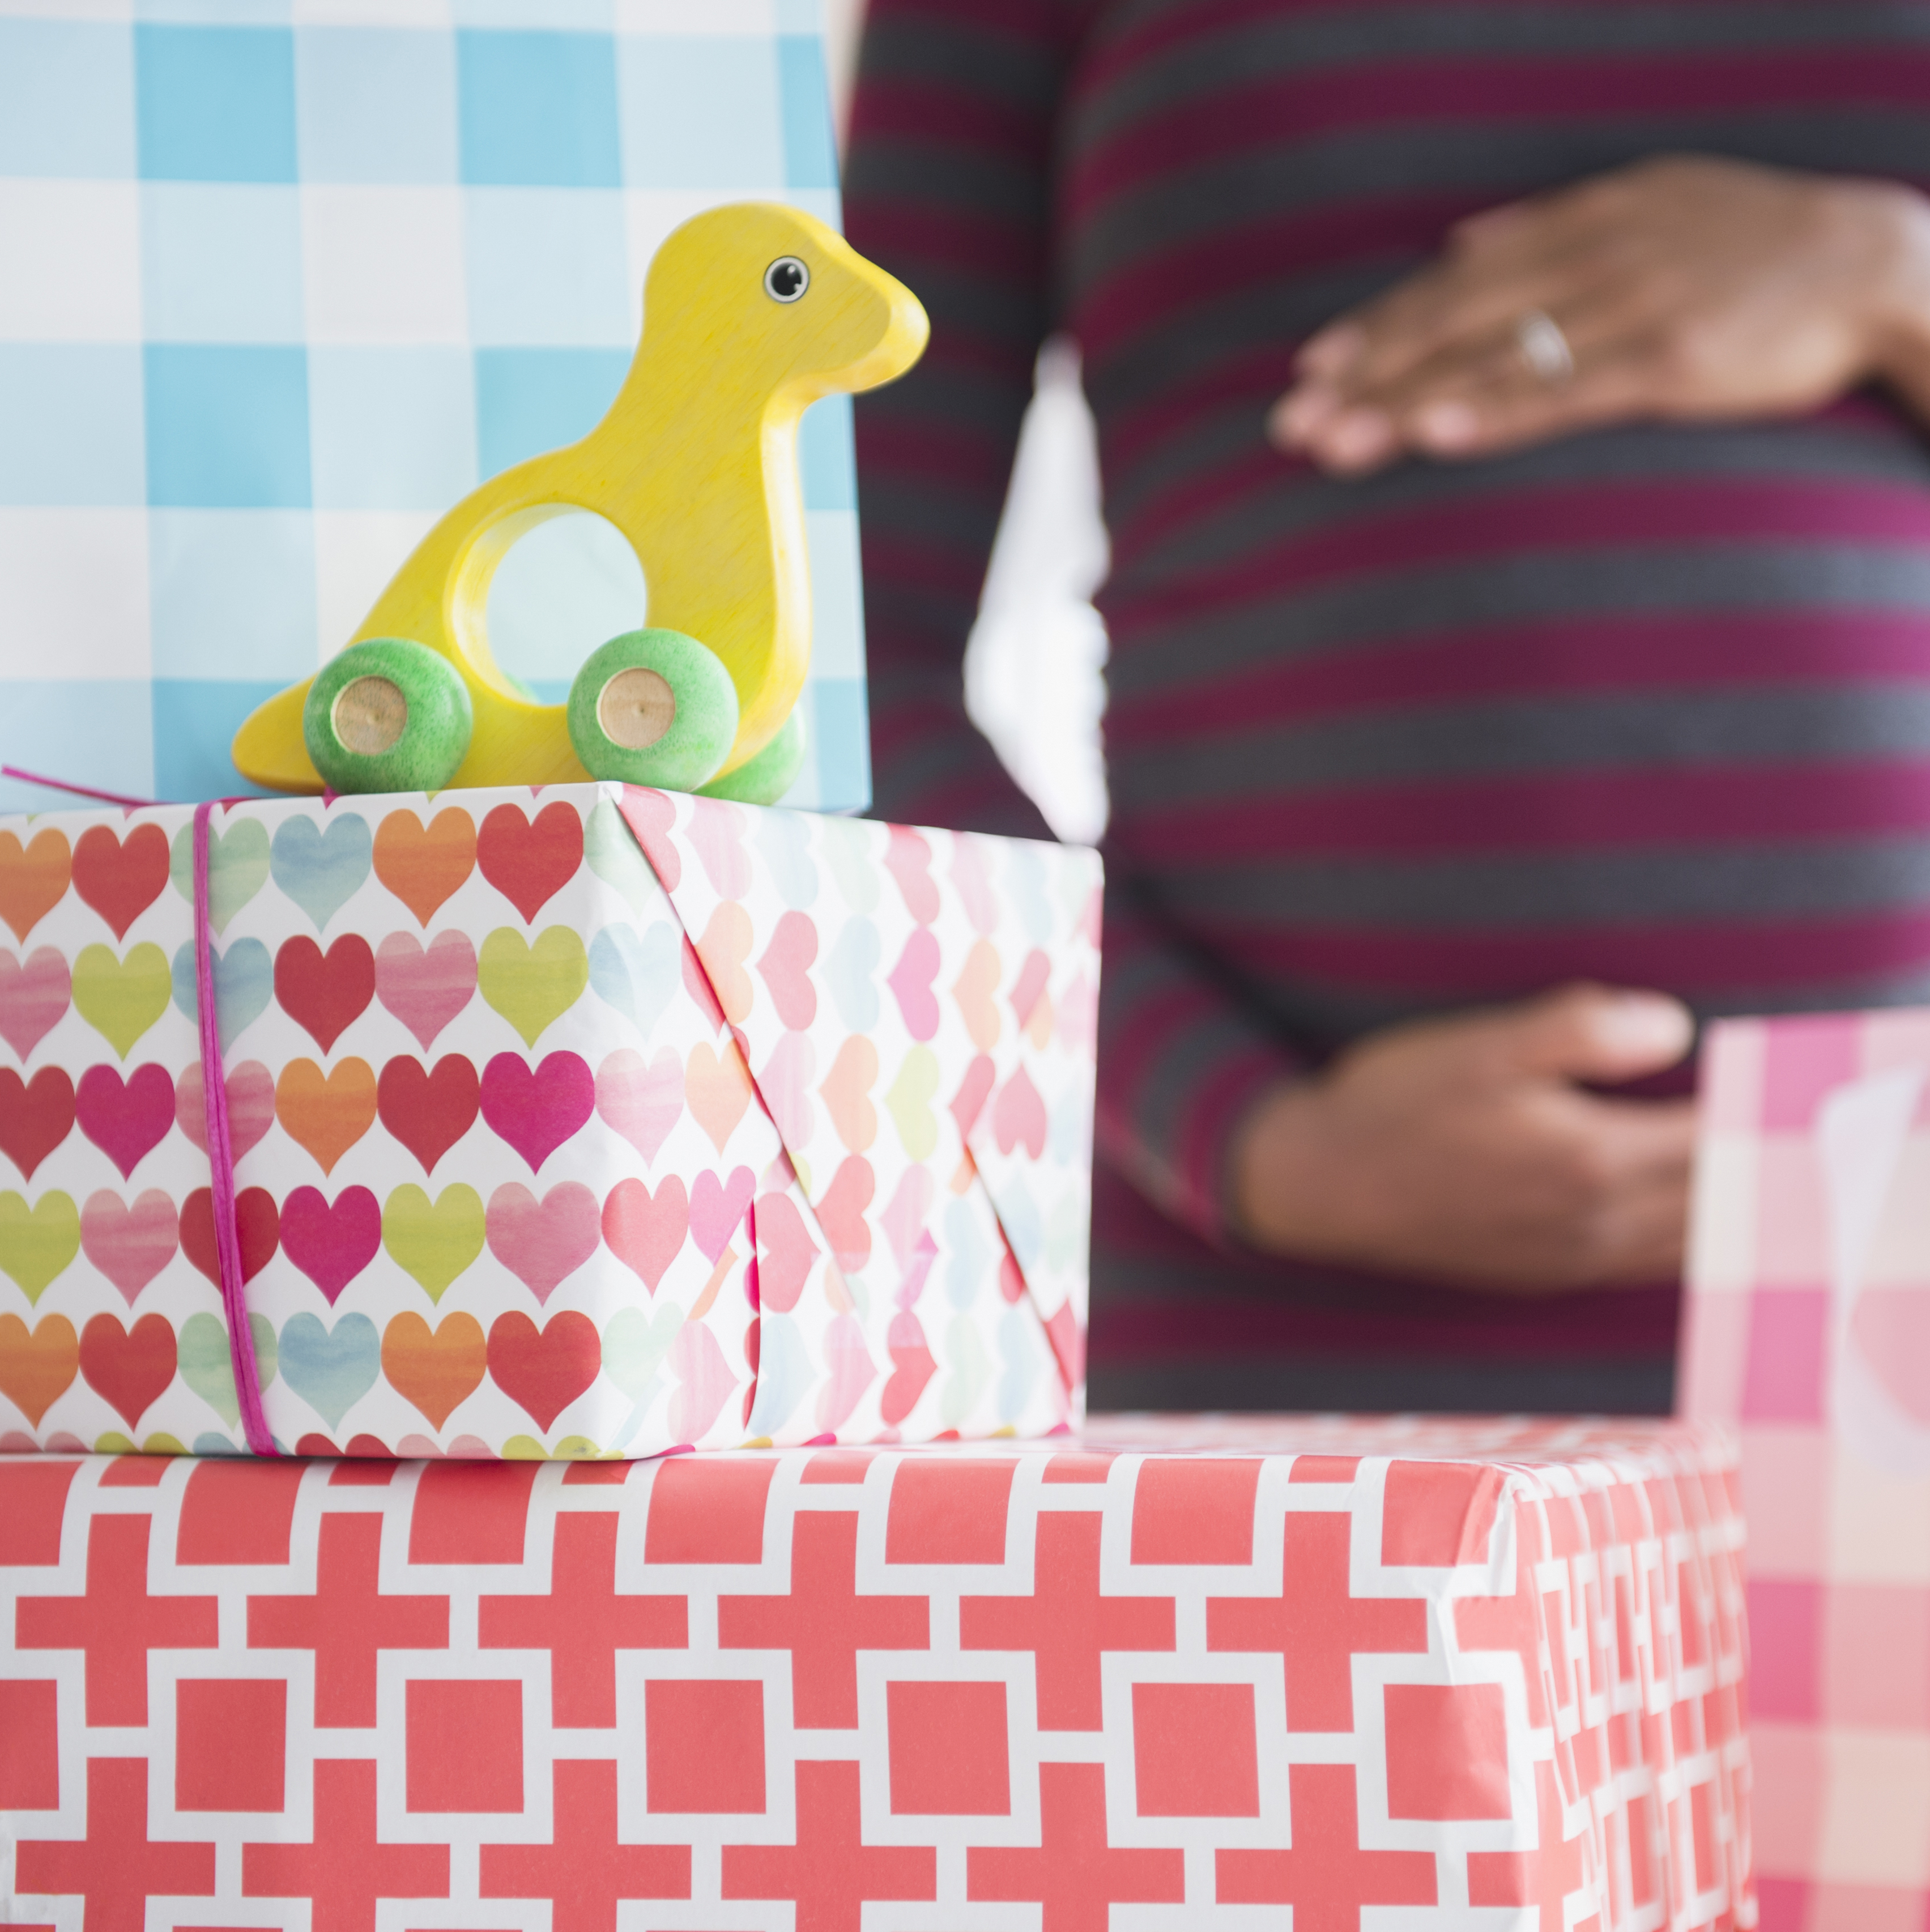
The Training
Receive quality care /Thrive in the community/Be safe in hospitals/clinics/community/ access resources
Mom/Birthing Person
Father/Partner
Baby

Slide 13
Birth equity training
Purpose:
  Provide an overview of Black maternal health and the need for birth equity.
  Gain understanding of the various factors that contribute to Black maternal and infant health and the mechanisms that aid in obtaining equity.
  The curriculum addresses bias and provides a respectful maternal health approach to reduce racism through birth stories from the perspectives of moms/birthing persons and fathers, public health field experts, birth workers, community advocates, and current health data.

Slide 14

Outline
Module | Title
1 | Introduction
2 | The Need for Birth Equity
3 | Community Engagement
4 | The Uncomfortable Truth of Bias
5 | The Black Postpartum Experience
6 | Respectful Maternal Care

Slide 15
Why Birth Equity?
A parent shared the looming acknowledgement every time she became pregnant surrounding her traumatization.
“The start of my long, long, lovely journey of that's not real, you don't know what you're talking about. So that was just the beginning of my journey, discovering that I had health problems that were ignored, going to be ignored, and had I known what I know today don't know that it would really change anything because I’m still not the licensed person to be able to tell somebody that there's something going on with my body and actually be heard.”
Notes:
View Results: https://www.polleverywhere.com/multiple_choice_polls/9TpHQvXWkAdxkLM3L1vEj?preview=true&controls=none

Slide 16
Community Engagement
Community Members Satisfaction of KBEN community engagement work
“I am impressed with the variety of stakeholders, especially those who were Black or another person of color, that were engaged in the network”
“As parents, I feel included and empowered during network meetings.”
Several interviewees explicitly identified the “research agenda” and how the membership was encouraged to lead and create it.

Slide 17
The Uncomfortable Truth of Bias
One parent shared,
“the stigma right there that we have to be super strong and we’re super women”.
Another parent stated,
“I noticed they treated me and my husband very badly. We had to continuously tell the hospital staff my birth plan and they kept trying to push their own agendas.”
Notes:
Switch over to web browser logged in to PollEv to display live results

Slide 18
The Black Postpartum Experience
One parent stated,
“I was never asked about their mental health and being fired while on maternity leave.”
One parent stated,
“No one told me anything. And I could probably for the first time, because I have been spotting the whole time anyway, so they may, no one knows when your placenta’s going to rupture, but the fact that I didn’t find out until five years later that’s exactly what happened—”

Slide 19
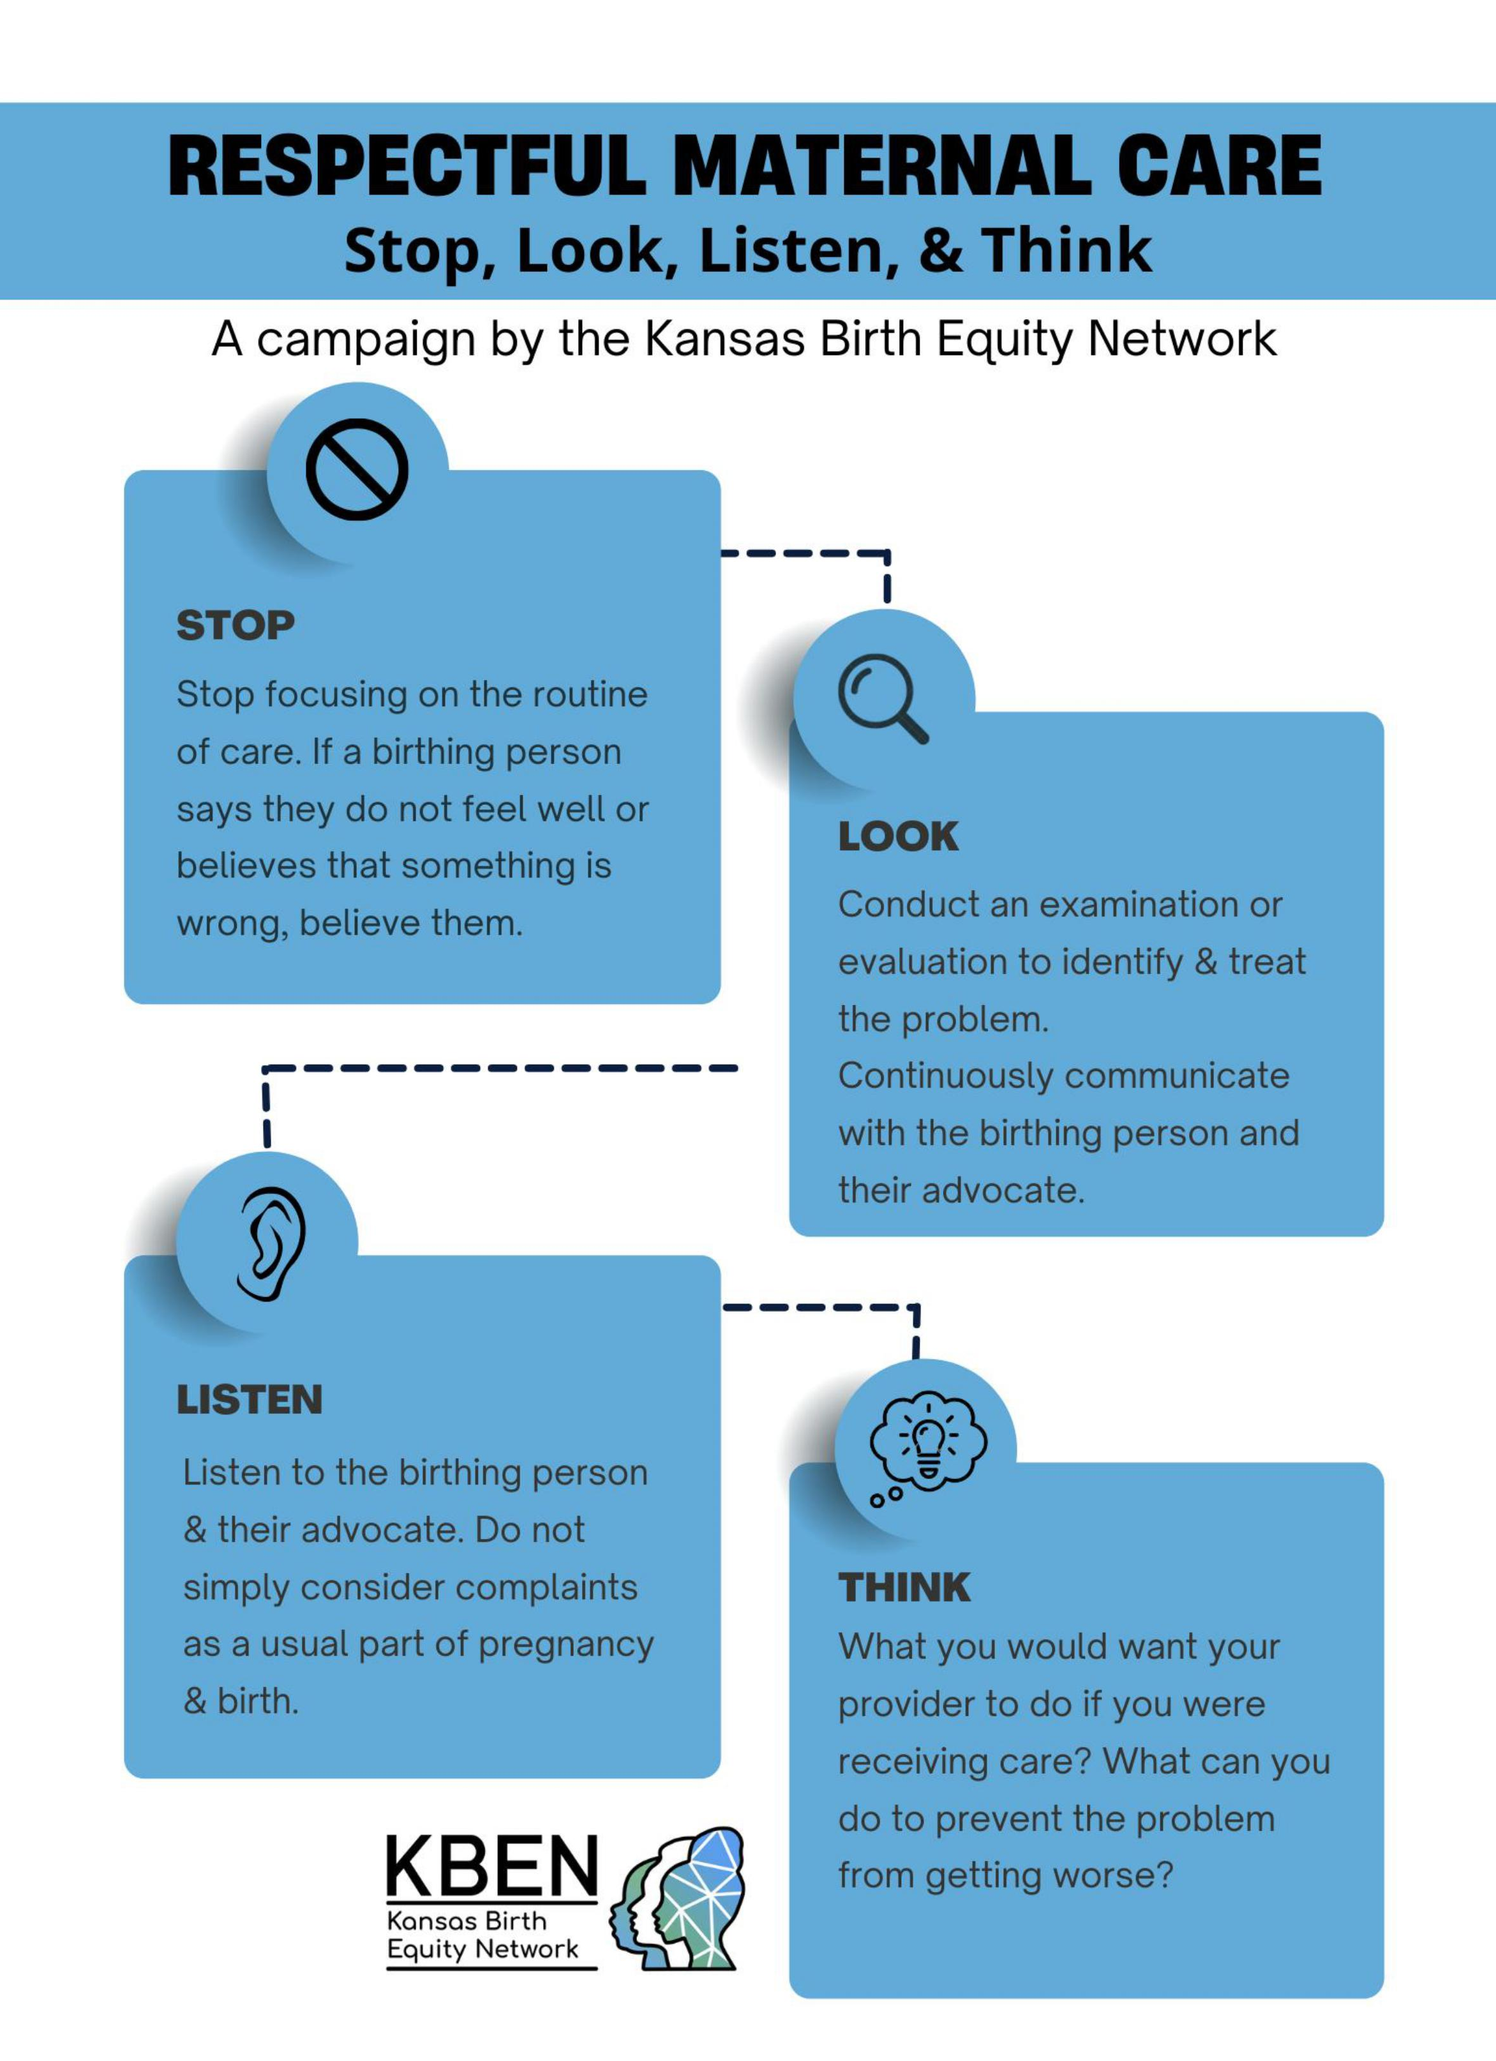
Respectful Maternal Care
The Stop, Look, Listen, & Think Campaign informed by community members in the Kansas Birth Equity Network.
In what ways can you encourage your organization to Stop, Look, Listen, & Think to ensure respectful maternal care?
Notes:
Switch over to web browser logged in to PollEv to display live results

Slide 20
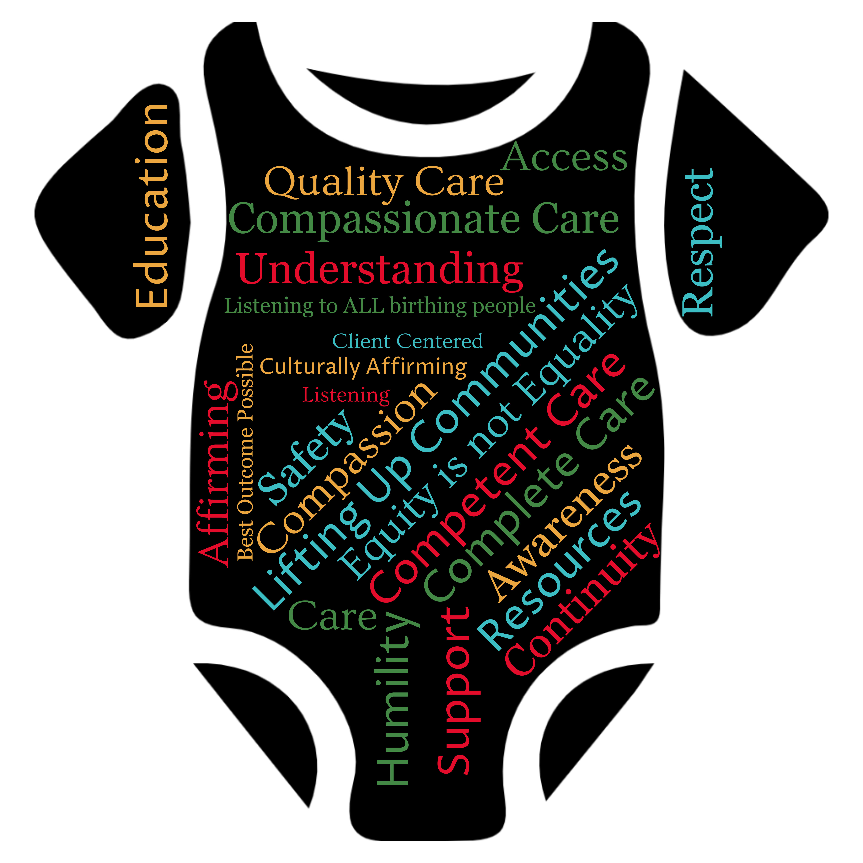
Birth Equity Training Results
What does birth equity mean to you?

Slide 21

Birth Equity Training Results
Coalition
Networking
Culturally Congruent Care
How might you engage community members to improve maternal health disparities?
Cultural Humility
Grassroots Work
Listening to the community
Action Planning
Collaboration
Partnerships

Slide 22

Birth Equity Training Results
Use expertise from the communities we serve
Provide follow up care and resources after discharge
Educate all health care workers
What can you/your organization do to improve postpartum support for the families you take care of?
Advocate for culturally congruent care
Make warm hand offs
Breastfeeding clinic
Listen to the patient and family and follow through
Include doulas in the care team
Advocate for paid family leave

Slide 23
Stand for me or raise your hand!
If you are a birthing person/someone calls you mom
You are a father/partner
You are an aunt
You are a daughter
You plan to have children
You are a community member that cares about the health and well-being of women/birthing persons and children

Slide 24

When Black Birthing Persons thrive, We all thrive!

Slide 25

Congratulations!
Curriculum Completions
Kari Smith
Katie Kufahl
Kayla Schroeder
Chelsea James
Jessica Seib
Brenda Blankenship
Dana Deters
Melissa ”Missy” Mourek
Kimberley Brey
Kimberlee Dick
In-Progress
Jessica Gier
Taylor Bertschy
Toni Carter
Emily Hester
Jessica Wasson
Kristin Perez

Slide 26
COVID-19 & Pregnancy
Developed with community members & stakeholders in KBEN.
If this is helpful for your patient population, please let us know. We are happy to mail printed copies.

Slide 27
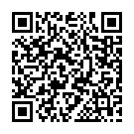

Learn More
Our Team:
Sharla Smith, PhD, MPH &
Michelle Redmond, PhD, MS
Oluoma Obi
Bernard Schuster
Sharon Wolff
Erin Attebery
Joi Wickliffe
Community Leadership:
CD366 Lead: Joy Barnes, Nicole Garner
Father’s Engagement Lead:
Kyle Ellison
Join the network: https://redcap.kumc.edu/surveys/?s=C7PAHM8W3P
https://www.kumc.edu/school-of-medicine/academics/departments/population-health/research/kansas-birth-equity-network.html
Follow us on Facebook @KSBHI
Contact us at: KBEN@KUMC.EDU

Slide 28
Questions/Comments

Slide 29
GROUP Activity
Complete Puzzles
Create a Birth Equity Statement

Slide 30
LIFT
At the University of Kansas Health System, we are devoted to fostering a safe and respectful environment while providing intentional medical care to birthing people of all races, ethnicities, genders, and identities. We LIFT our patients up for the best possible experience.
L We Listen to our patients’ concerns with an open mind.
I We provide Intentional care while addressing our own implicit bias.
F Our team Fosters a safe and respectful environment by providing continuous support, maintaining patient dignity and privacy, ensuring patient freedom from mistreatment, and enabling informed choice.*
T We build Trust with our patients through transparency and shared decision making.
*Adapted WHO recommendations: intrapartum care for a positive childbirth experience. Geneva: World Health Organization; 2018. Licence: CC BY-NC-SA 3.0 IGO.

