Slide 1

Hypertension – The Low-Hanging Fruit
Bree Fallon, RN
Traci Johnson, MD

Slide 2
Disclosures
We have no disclosures…yet.

Slide 3
Objectives
Review diagnosis and distribution of hypertensive disorders in the US
Describe the high-yield portions of the hypertension in pregnancy protocol in outpatient, inpatient, and ED settings
List 3 actionable ways those caring for women and birthing people can help decrease hypertensive morbidity in the peripartum period

Slide 4
01
HYPERTENSION IN OUR POPULATION
02
HYPERTENSION MANAGEMENT
03
CASE REVIEWS
04
Q&A
OBJECTIVES
Population Data
Review of protocols
Real word application

Slide 5

01
HYPERTENSION IN OUR POPULATION

Slide 6
The Problem
Hypertensive disorders affect approximately 16% of pregnancies and are increasing with the rising prevalence of cardiometabolic diseases in younger women and birthing people.

Slide 7

—SOMEONE FAMOUS
“When you know better, you do better.”

Slide 8


Sequelae of Severe Hypertension
DEFINITION OF CONCEPTS
Preeclampsia
Cardiac Arrest, Stroke, Liver Rupture,
DIC, Abruption
HELLP, Eclampsia, Preeclampsia with Severe Features, Gestational Hypertension
Chronic Hypertension with/without Superimposed Preeclampsia

Slide 9
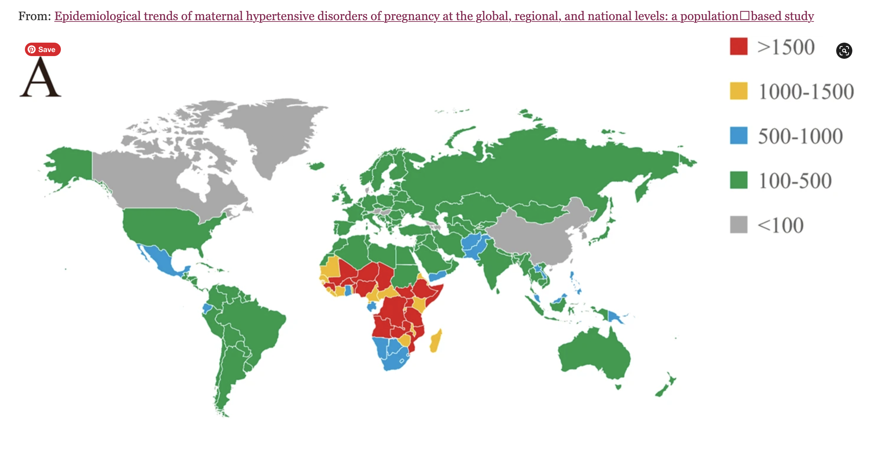
Global Effect
Hypertensive disorders effect birthing people globally
Maternal morbidity
Stillbirths
Neonatal Morbidity & Mortality
Notes:
30% of al maternal near-miss events will be due to pregnancy hypertension according to a review published in 2018.
Of the 2.6 million stillbirths annually, approximately 16% occur in pregnancies complicated by hypertensive disorders of pregnancy of which 11% are CHTN and 5% are preeclampsia
Neonatal mortality is also affected by HDP with 10% of early neonatal deaths (8/1000 neonatal deaths) and 3/1000 late neonatal deaths. Drum roll – this amounts to 1.5-2 million neonatal deaths ANNUALL in the world.
Neonatal morbidity is gravely affected by HDP. Iatrogenic prematurity due to indicated delivery, fetal growth restriction with or without hypoxic ischemic encephalopathy is markedly increased and is 10-20x the rate of neonatal mortality.

Slide 10
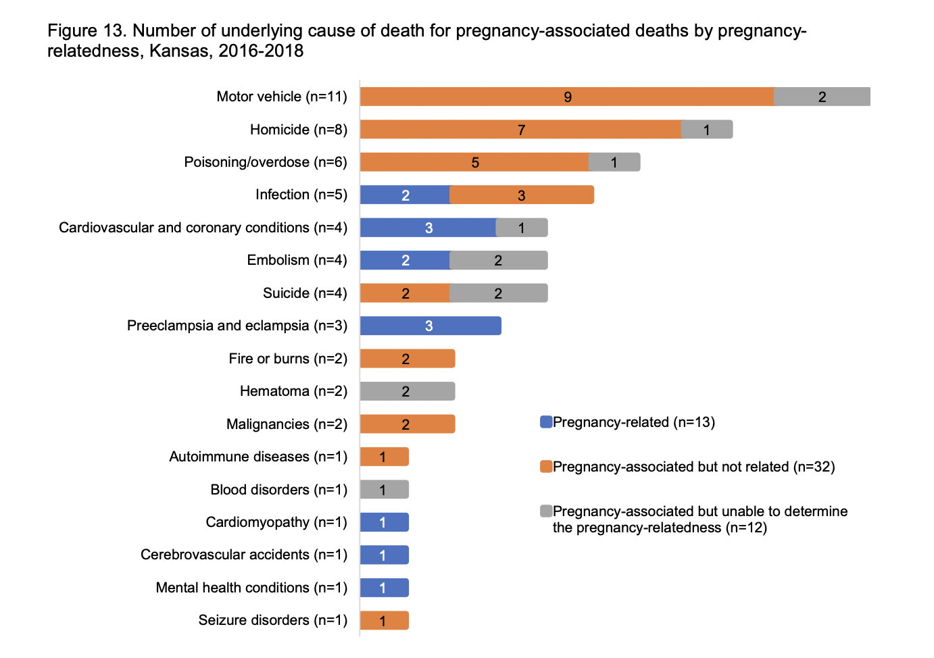
THIS IS A TABLE
 | 1938 | 1940 | 1942 | 1944 | 1946
MERCURY | 12 | 23 | 26 | 34 | 36
VENUS | 123 | 444 | 321 | 235 | 452
MARS | 457 | 864 | 1000 | 567 | 678
JUPITER | 34 | 76 | 125 | 97 | 76

Slide 11
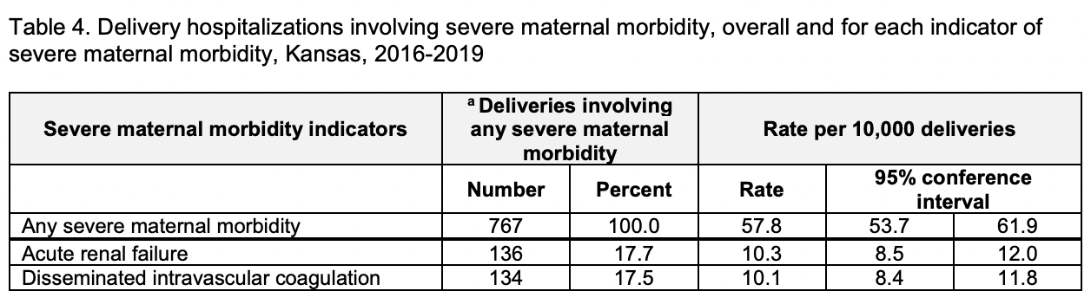
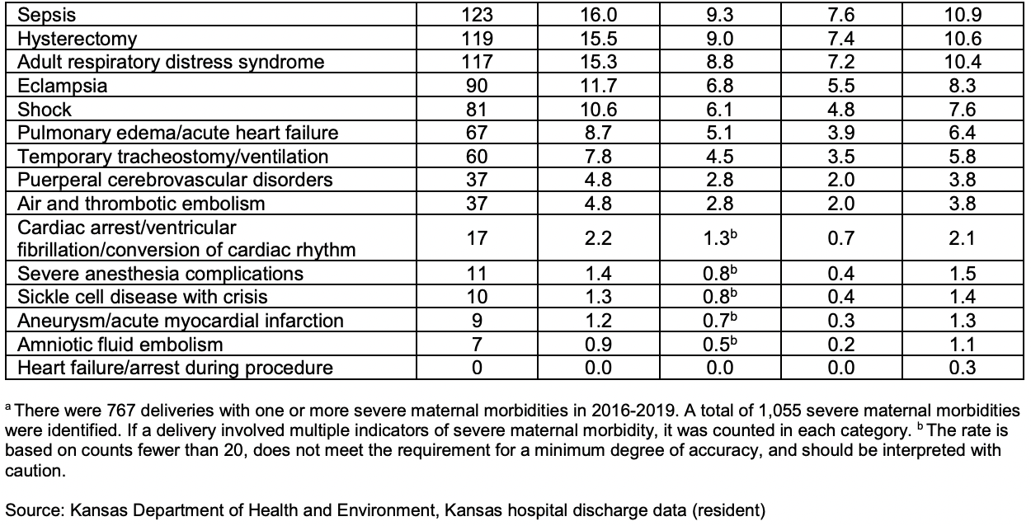
MATERNAL MORBIDITY
 | 1938 | 1940 | 1942 | 1944 | 1946
MERCURY | 12 | 23 | 26 | 34 | 36
VENUS | 123 | 444 | 321 | 235 | 452
MARS | 457 | 864 | 1000 | 567 | 678
JUPITER | 34 | 76 | 125 | 97 | 76

Slide 12
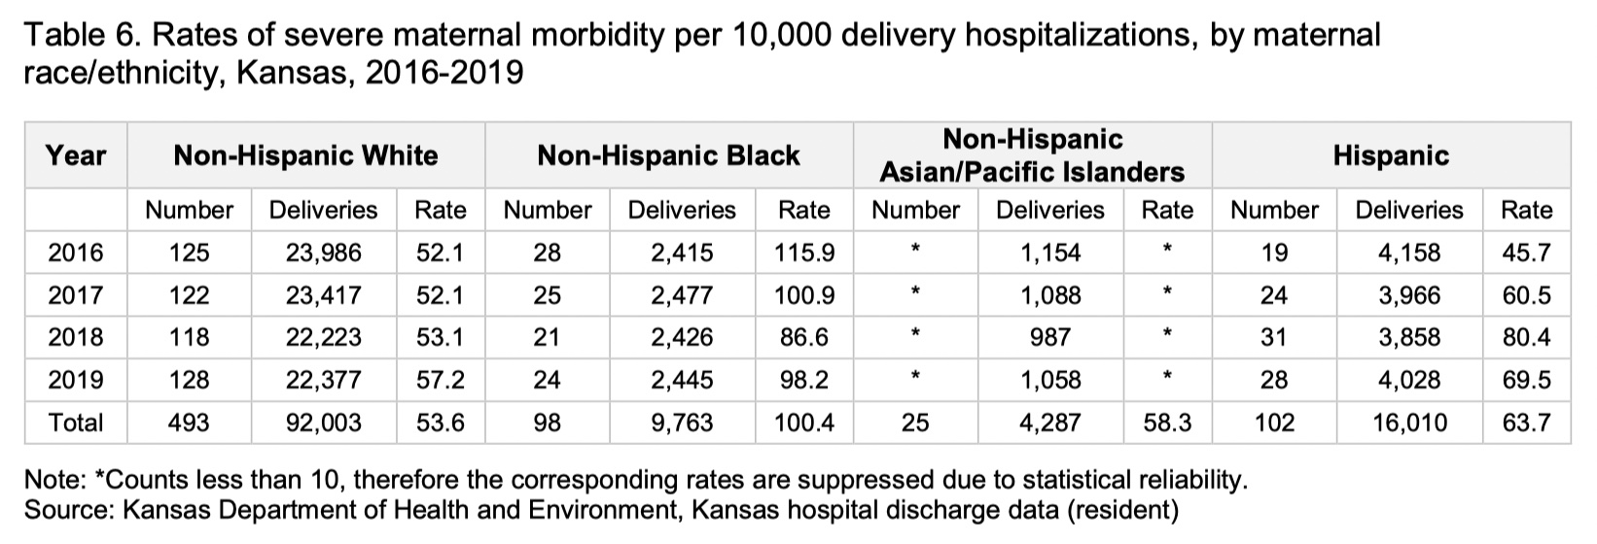
Notes:
The leading causes of death were cardiovascular and coronary conditions, followed by preeclampsia and eclampsia, embolism, and infection.
12 (92.3%) of the 13 deaths were preventable with 7 deaths (58.3%) showing a good chance of prevention and 5 deaths (41.7%) had some chance.
• Racial and ethnic minorities were disproportionately affected. About two-thirds (8 deaths, 61.5%) were racial and ethnic minorities and 5 deaths (38.5%) were nonHispanic White women.

Slide 13
02
HYPERTENSION MANAGEMENT

Slide 14
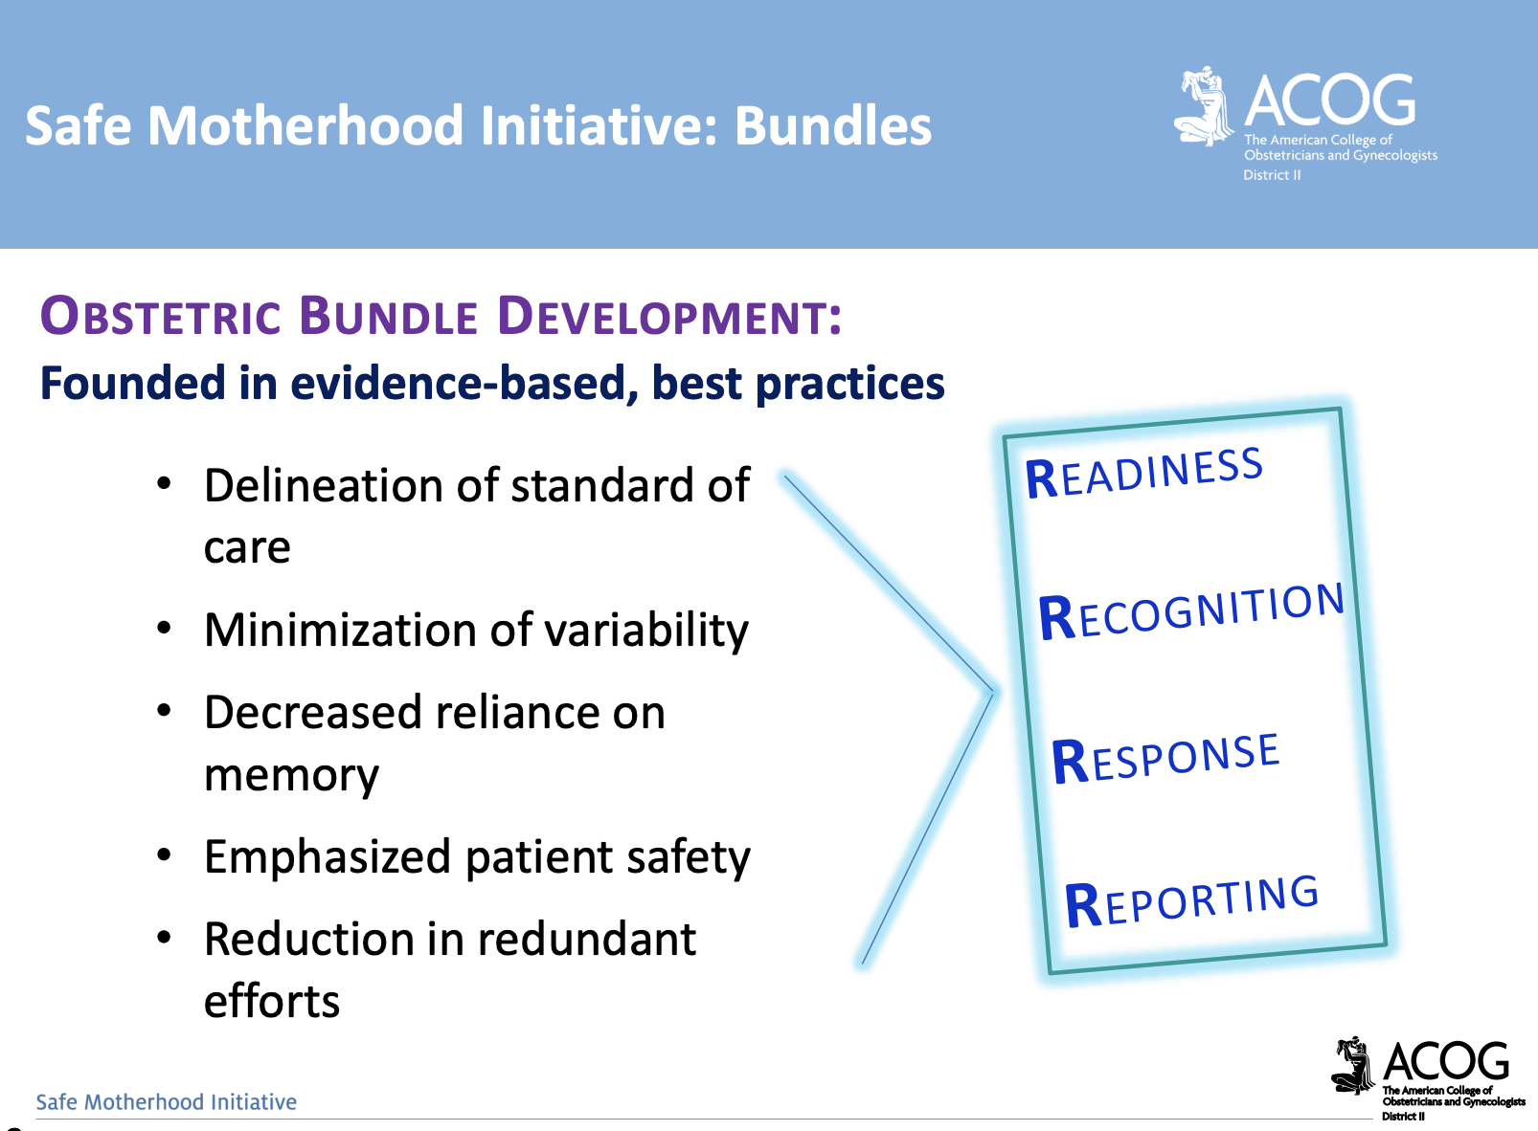

Slide 15
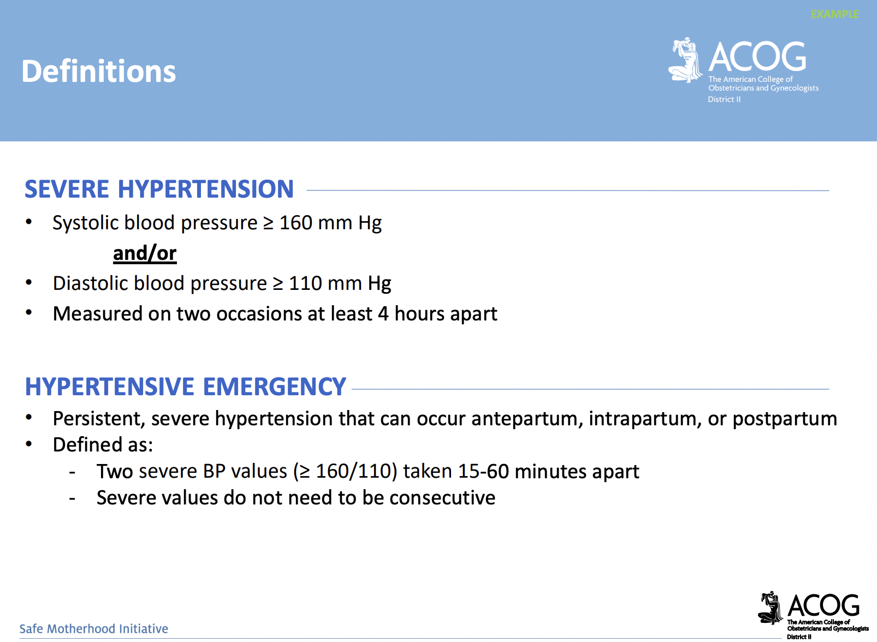

Slide 16
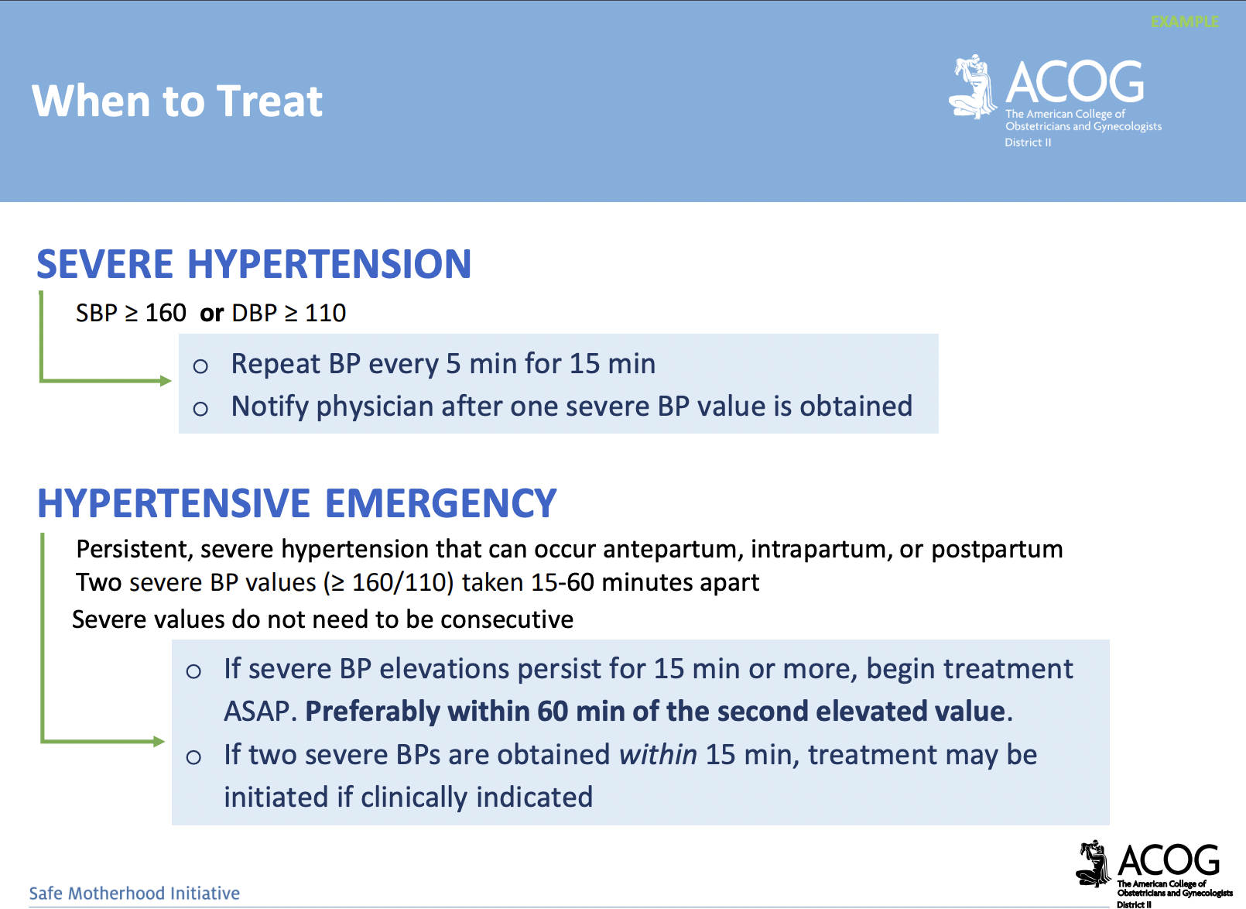

Slide 17
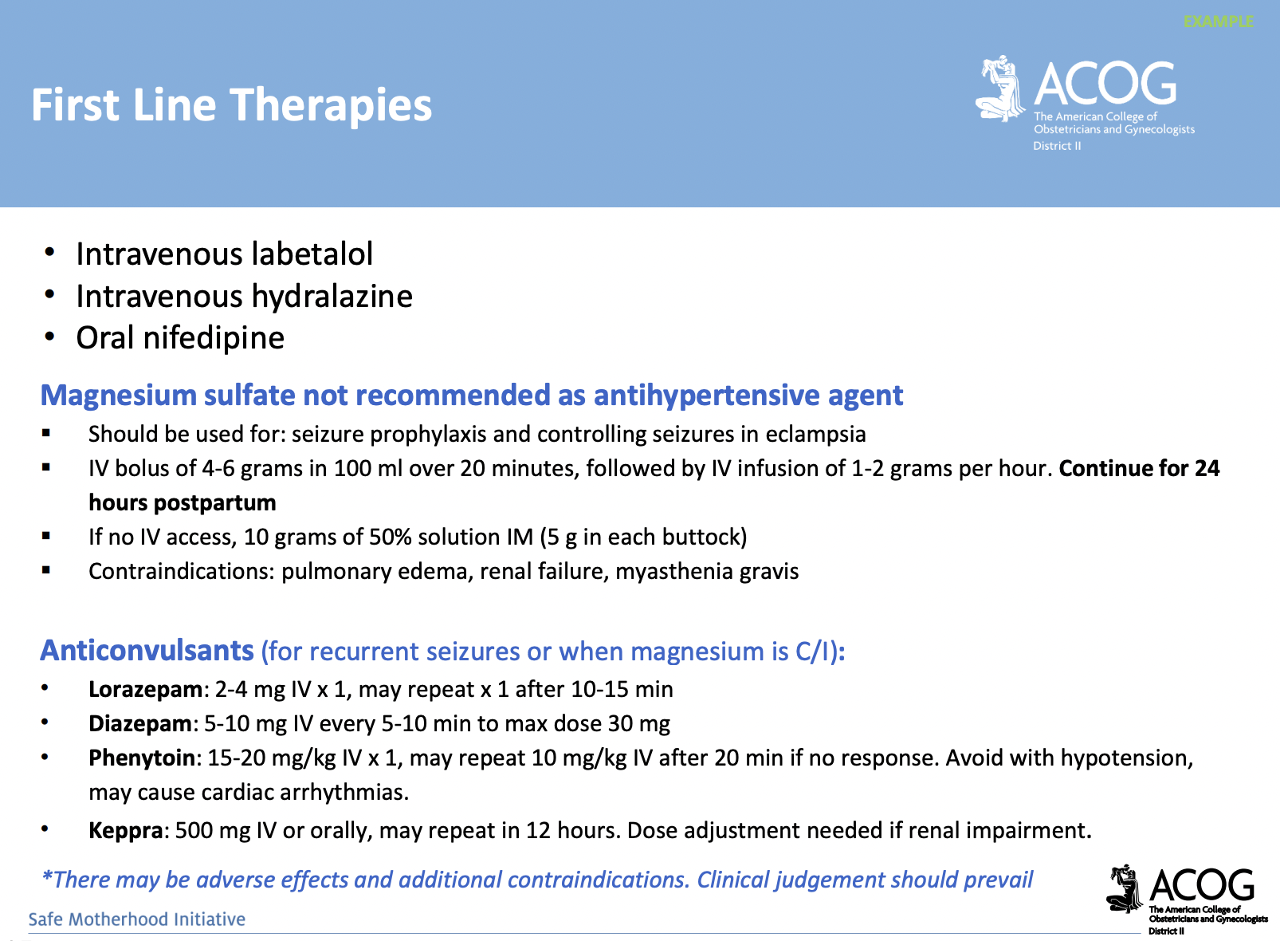

Slide 18
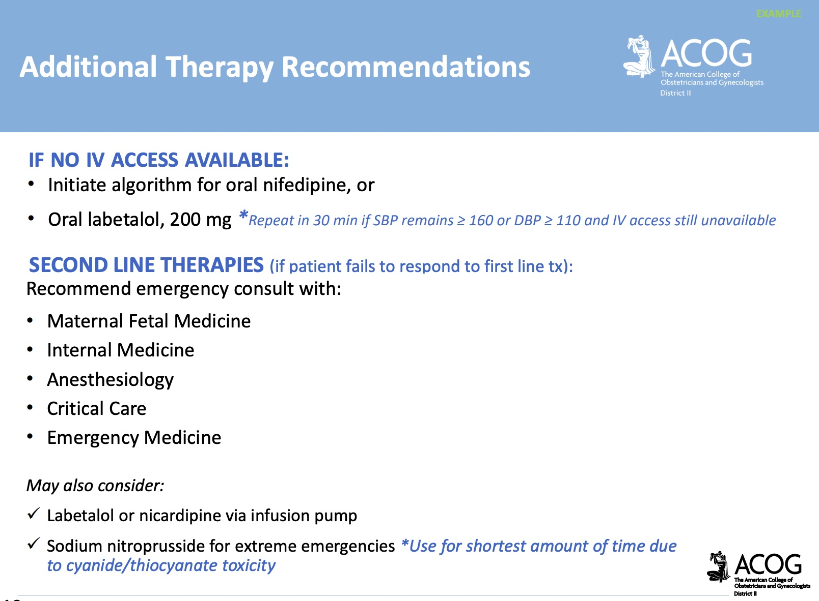

Slide 19
03
CASE REVIEWS

Slide 20

CASE 1
24 y/o G1 @ 37 weeks presents to triage with headache, abdominal pain.
PMH/PSH: none
Meds: PNV, iron
ALL: none

Slide 21
CASE 1
24 y/o G1 @ 37 weeks presents to triage with headache, abdominal pain. ROS oliguria
VS: 162/112, HR 106, RR 18, O2 sat 94%, AF
Exam: neg, EFM reactive, toco q 5’
Labs: Hb 13, Plt 236, LFTs/Cr wnl,
UPC 1200

Slide 22
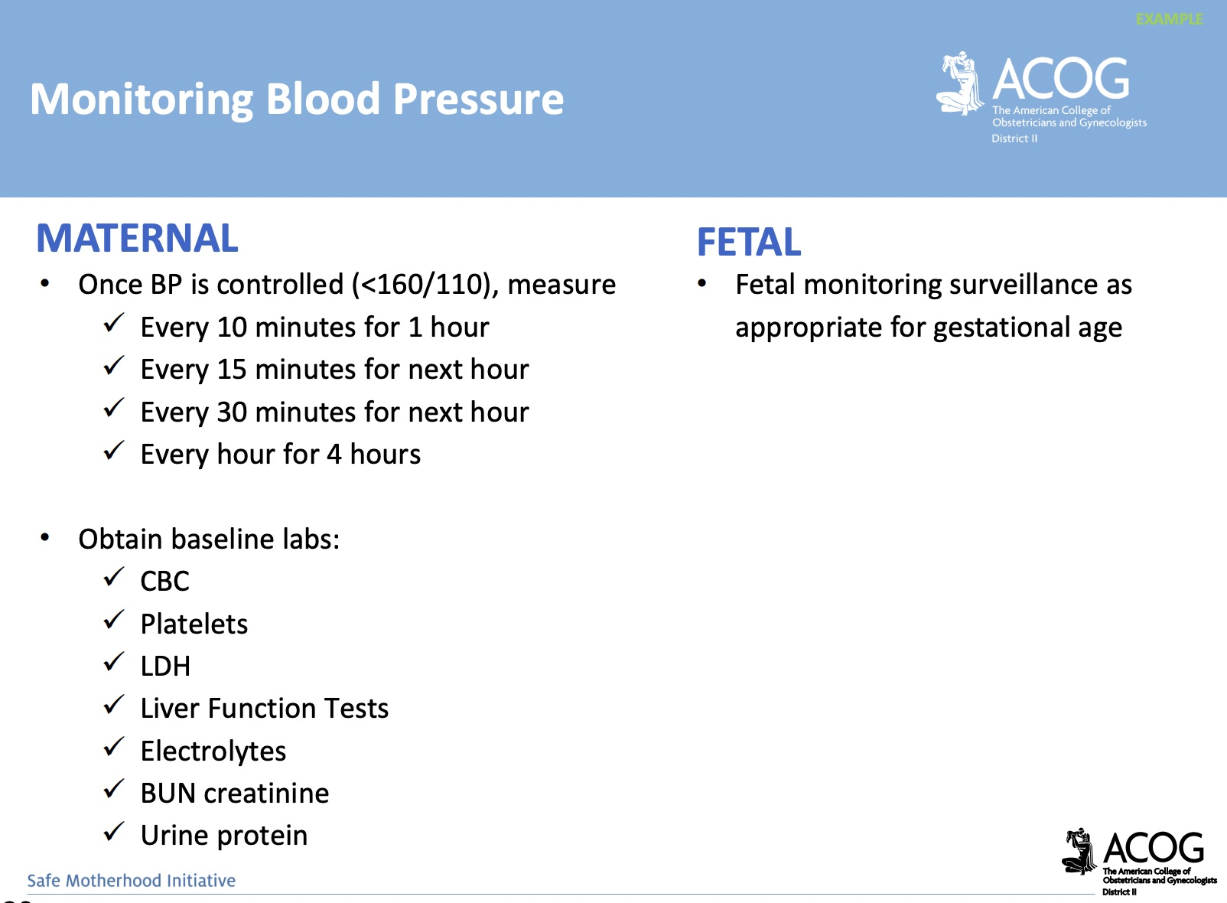

Slide 23
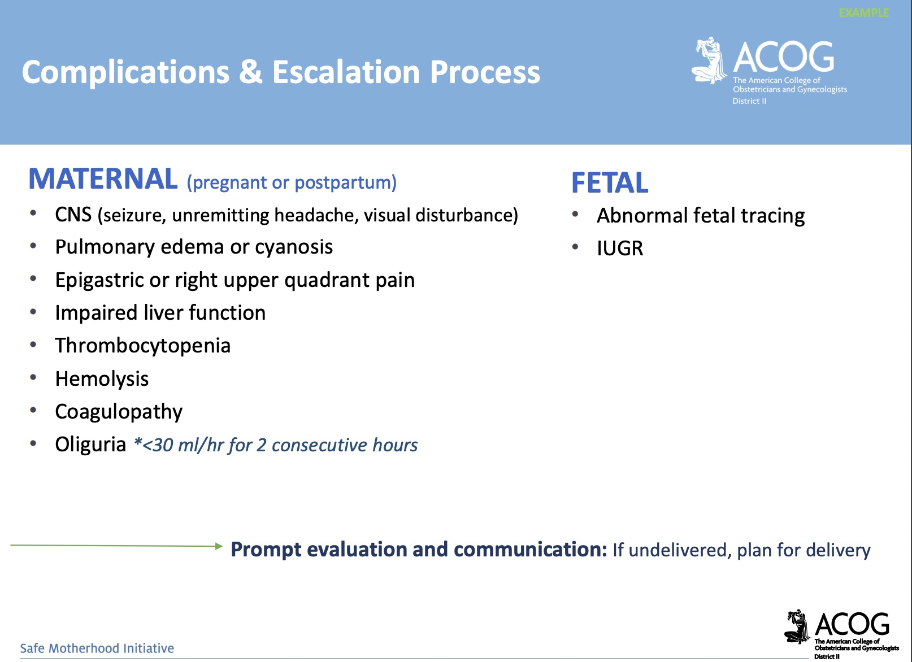

Slide 24


Slide 25

ADVOCACY
CASE 1
RISK FACTORS for severe morbidity (OLIGURIA) → escalation of care
Consider multidisciplinary consultation
Consider transfer to higher level of care
Expedite delivery
support for or recommendation of a particular cause
ALIGNMENT
An arrangement of groups or forces in relation to one or another

Slide 26


CASE 2
28 y/o G5P3012 POD#8 s/p emerg C/S with swelling and heavy bleeding.
PMH/PSH/POBGYNHx: C/S, pre-e in G1-3, SUID death of G2 at 3 months

Slide 27
CASE 2
28 y/o G5P3012 POD#8 s/p emerg C/S with swelling and heavy bleeding.
Meds/ALL: iron, oxy, ibuprofen, Tylenol
SocHx: neg

Slide 28
CASE 2
28 y/o G5P3012 POD#8 s/p emerg C/S with swelling and heavy bleeding.
VS 170/106, HR 99, AF, RR 18
Exam: neg, minimal bleeding
Labs: Hb 9.6, Plts 180, LFTs/Cr wnl neg

Slide 29
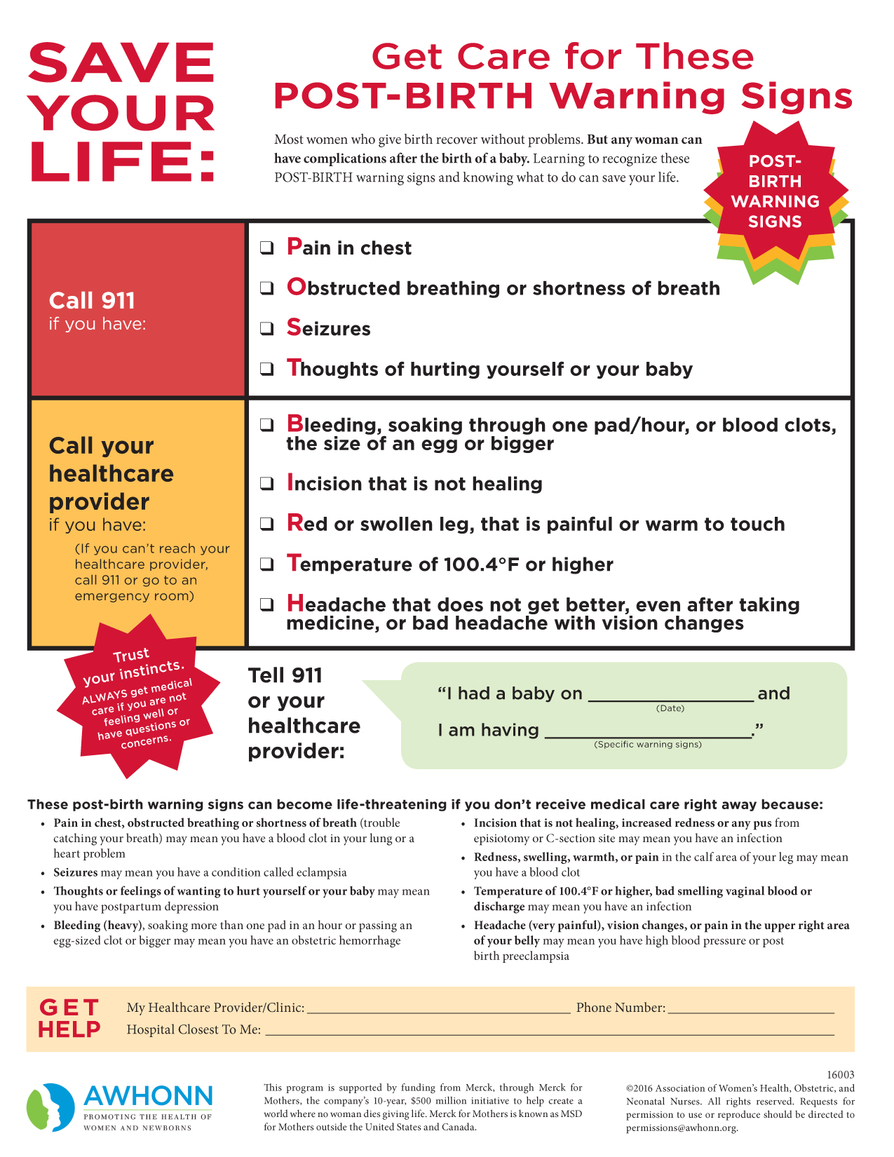
The patient should have been given discharge education and information regarding warning signs.

Slide 30
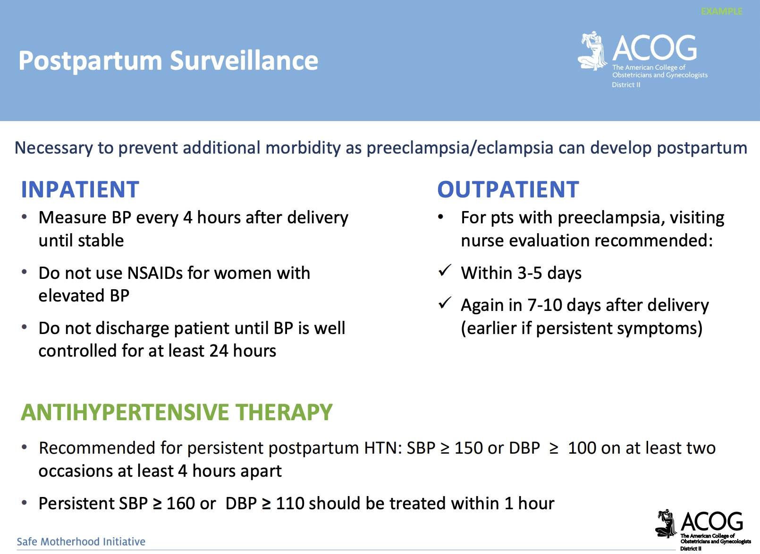

Slide 31
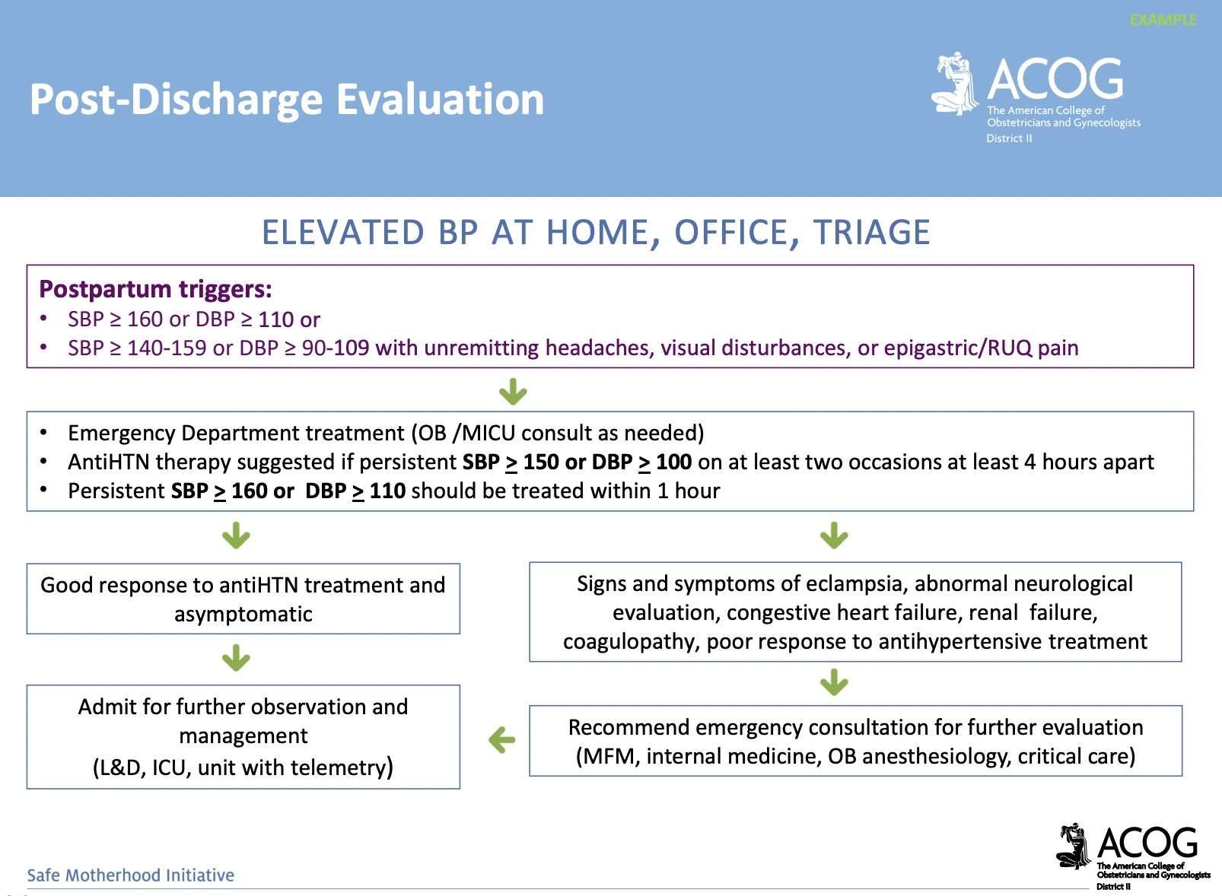

Slide 32
CASE 2
28 y/o G5P3012 POD#8 s/p emerg C/S with swelling and heavy bleeding.
SDOH: She is unable to stay for admission. She has children at home without childcare…

Slide 34

CASE 2
Autonomy
Adjustment
Self-directing freedom, especially moral independence
A correction or modification to reflect actual conditions

Slide 35
Transportation
Case Management
Tele-health
SDOH Modifications
Frequent Outpatient Visits
Doulas and CHWs
Emergency Care
Insurance options to assist ensure appointments are kept
Insurance and hospital case management to ensure close interval follow up
Utilizing multiple ways to engage with patients
Serial management if patient unable to be admitted
Community-based wrap-around services save lives and meet patients where they are
Temporary Foster. Care Resources

Slide 36

CASE 3
26 y/o G1 @ 35 weeks seen for ROB. ROS neg.
BP 147/75, repeat 135/95, otherwise VSS
Exam neg, FH 33 cm, FHT 140s
Urine dip 3+ protein

Slide 37
MANAGEMENT
STRATIFY RISK
01
Symptoms
Labs
US to rule out growth restriction
Antepartum testing
Late Preterm HDP
02
CLOSE INTERVAL FOLLOW UP
Weekly Labs
Weekly antepartum testing
DELIVERY
03
Delivery 37 weeks
Escalation of care, as indicated

Slide 38
Awareness
Knowledge or perception of the situation or facts
Evidence-based and protocol-based care saves lives and decreases effects of unconscious bias

Slide 39





COMMENTS
QUESTIONS
THANK YOU
REMARKS
CONCERNS

Slide 40

TELL YOUR FRIENDS

Slide 41
References
Association of Women's Health, Obstetric and Neonatal Nurses
1800 M Street, NW, Suite 740S Washington, DC 20036
Wang, W., Xie, X., Yuan, T. et al. Epidemiological trends of maternal hypertensive disorders of pregnancy at the global, regional, and national levels: a population‐based study. BMC Pregnancy Childbirth 21, 364 (2021). https://doi.org/10.1186/s12884-021-03809-2
Council on Patient Safety in Women's Health Care. https://safehealthcareforeverywoman.org/aim-data/. https://safehealthcareforeverywoman.org/wp-content/uploads/2020/06/FINAL_ANNOTATED_AIM-SMM-Updated-Code-Listclean_06272020.xlsx. Updated 6/29/2020.
Kansas Department of Health and Environment. Kansas Maternal Mortality Report, 2016-2018. December 2020.
National Academies of Sciences, Engineering, and Medicine. 2019. Integrating social care into the delivery of health care: Moving upstream to improve the nation’s health. Washington, DC: The National Academies Press. https://doi.org/10.17226/25467.
National Academies of Sciences, Engineering, and Medicine. 2019. Integrating Social Care into the Delivery of Health Care: Moving Upstream to Improve the Nation's Health. Washington, DC: The National Academies Press. https://doi.org/10.17226/25467.

